Slide 1
A better Sort of Yelp Photos

Slide 2
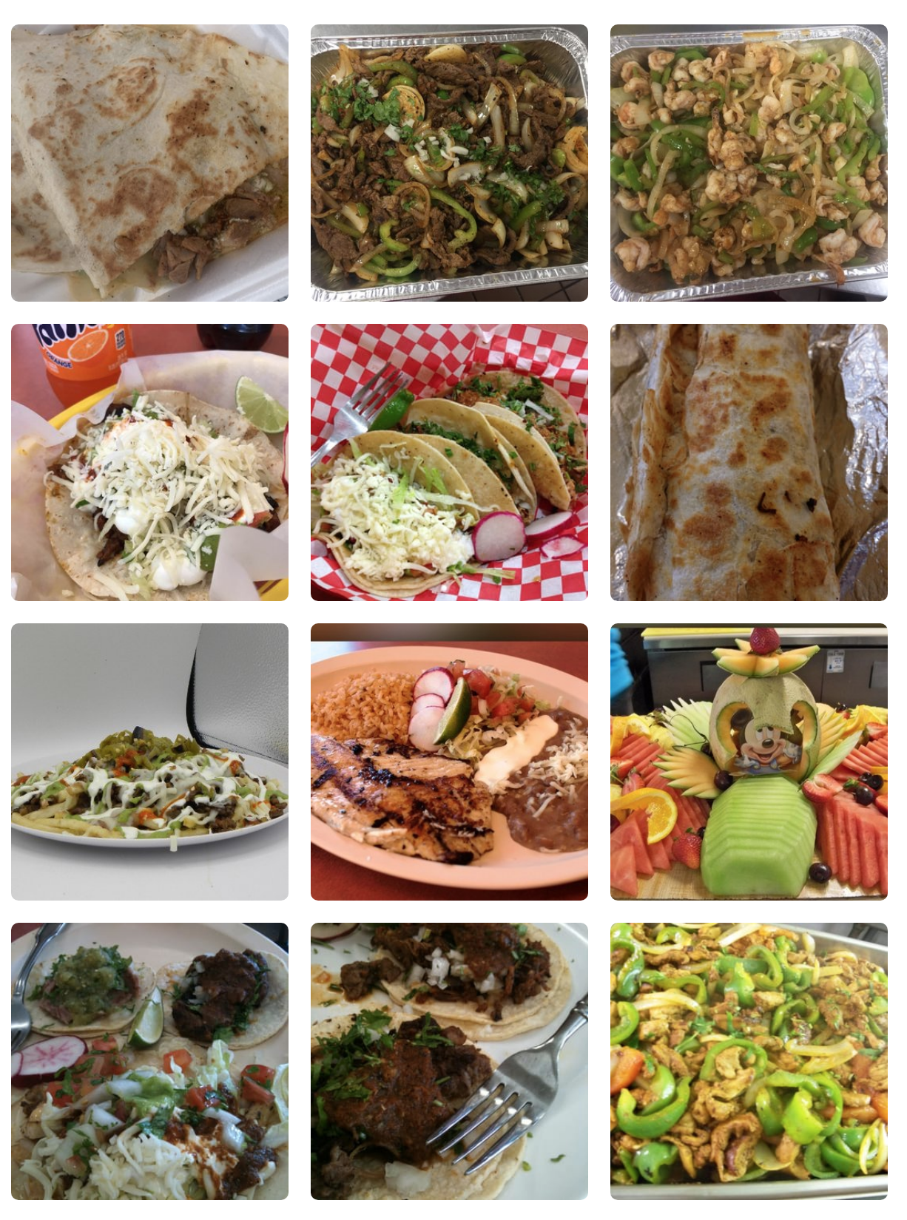
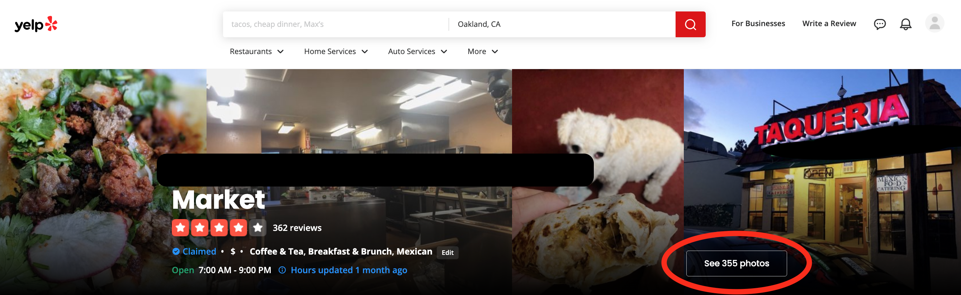
Problem Statement
Why are the photos in many Yelp restaurant galleries still poor quality? App users and owners deserve a better sort option.
Notes:
Given the influence of photos on consumer decisions, it's surprising how many restaurants still have a slough of dark, blurry, unappetizing photos immediately visible in their main photo gallery linked at the top of their Yelp page. Yelp app users, restaurant owners, and Yelp itself would all benefit from having an option to automatically sort restaurant photo galleries in a way that would place well taken shots on top. Currently on Yelp, businesses who have an advertising account can sort their photo gallery, so why do so many bad and blurry photos persist? Probably because it takes an owner's valuable time, plus requires knowledge of photographic principles to do these things. In this project I manually label a set of photos using photography principles, then trained a machine learning model to classify food photos as either "post-worthy" or "not so great" so that Yelp (or the restaurant owner or the app user) can automatically sort their photo galleries in a better way.

Slide 3
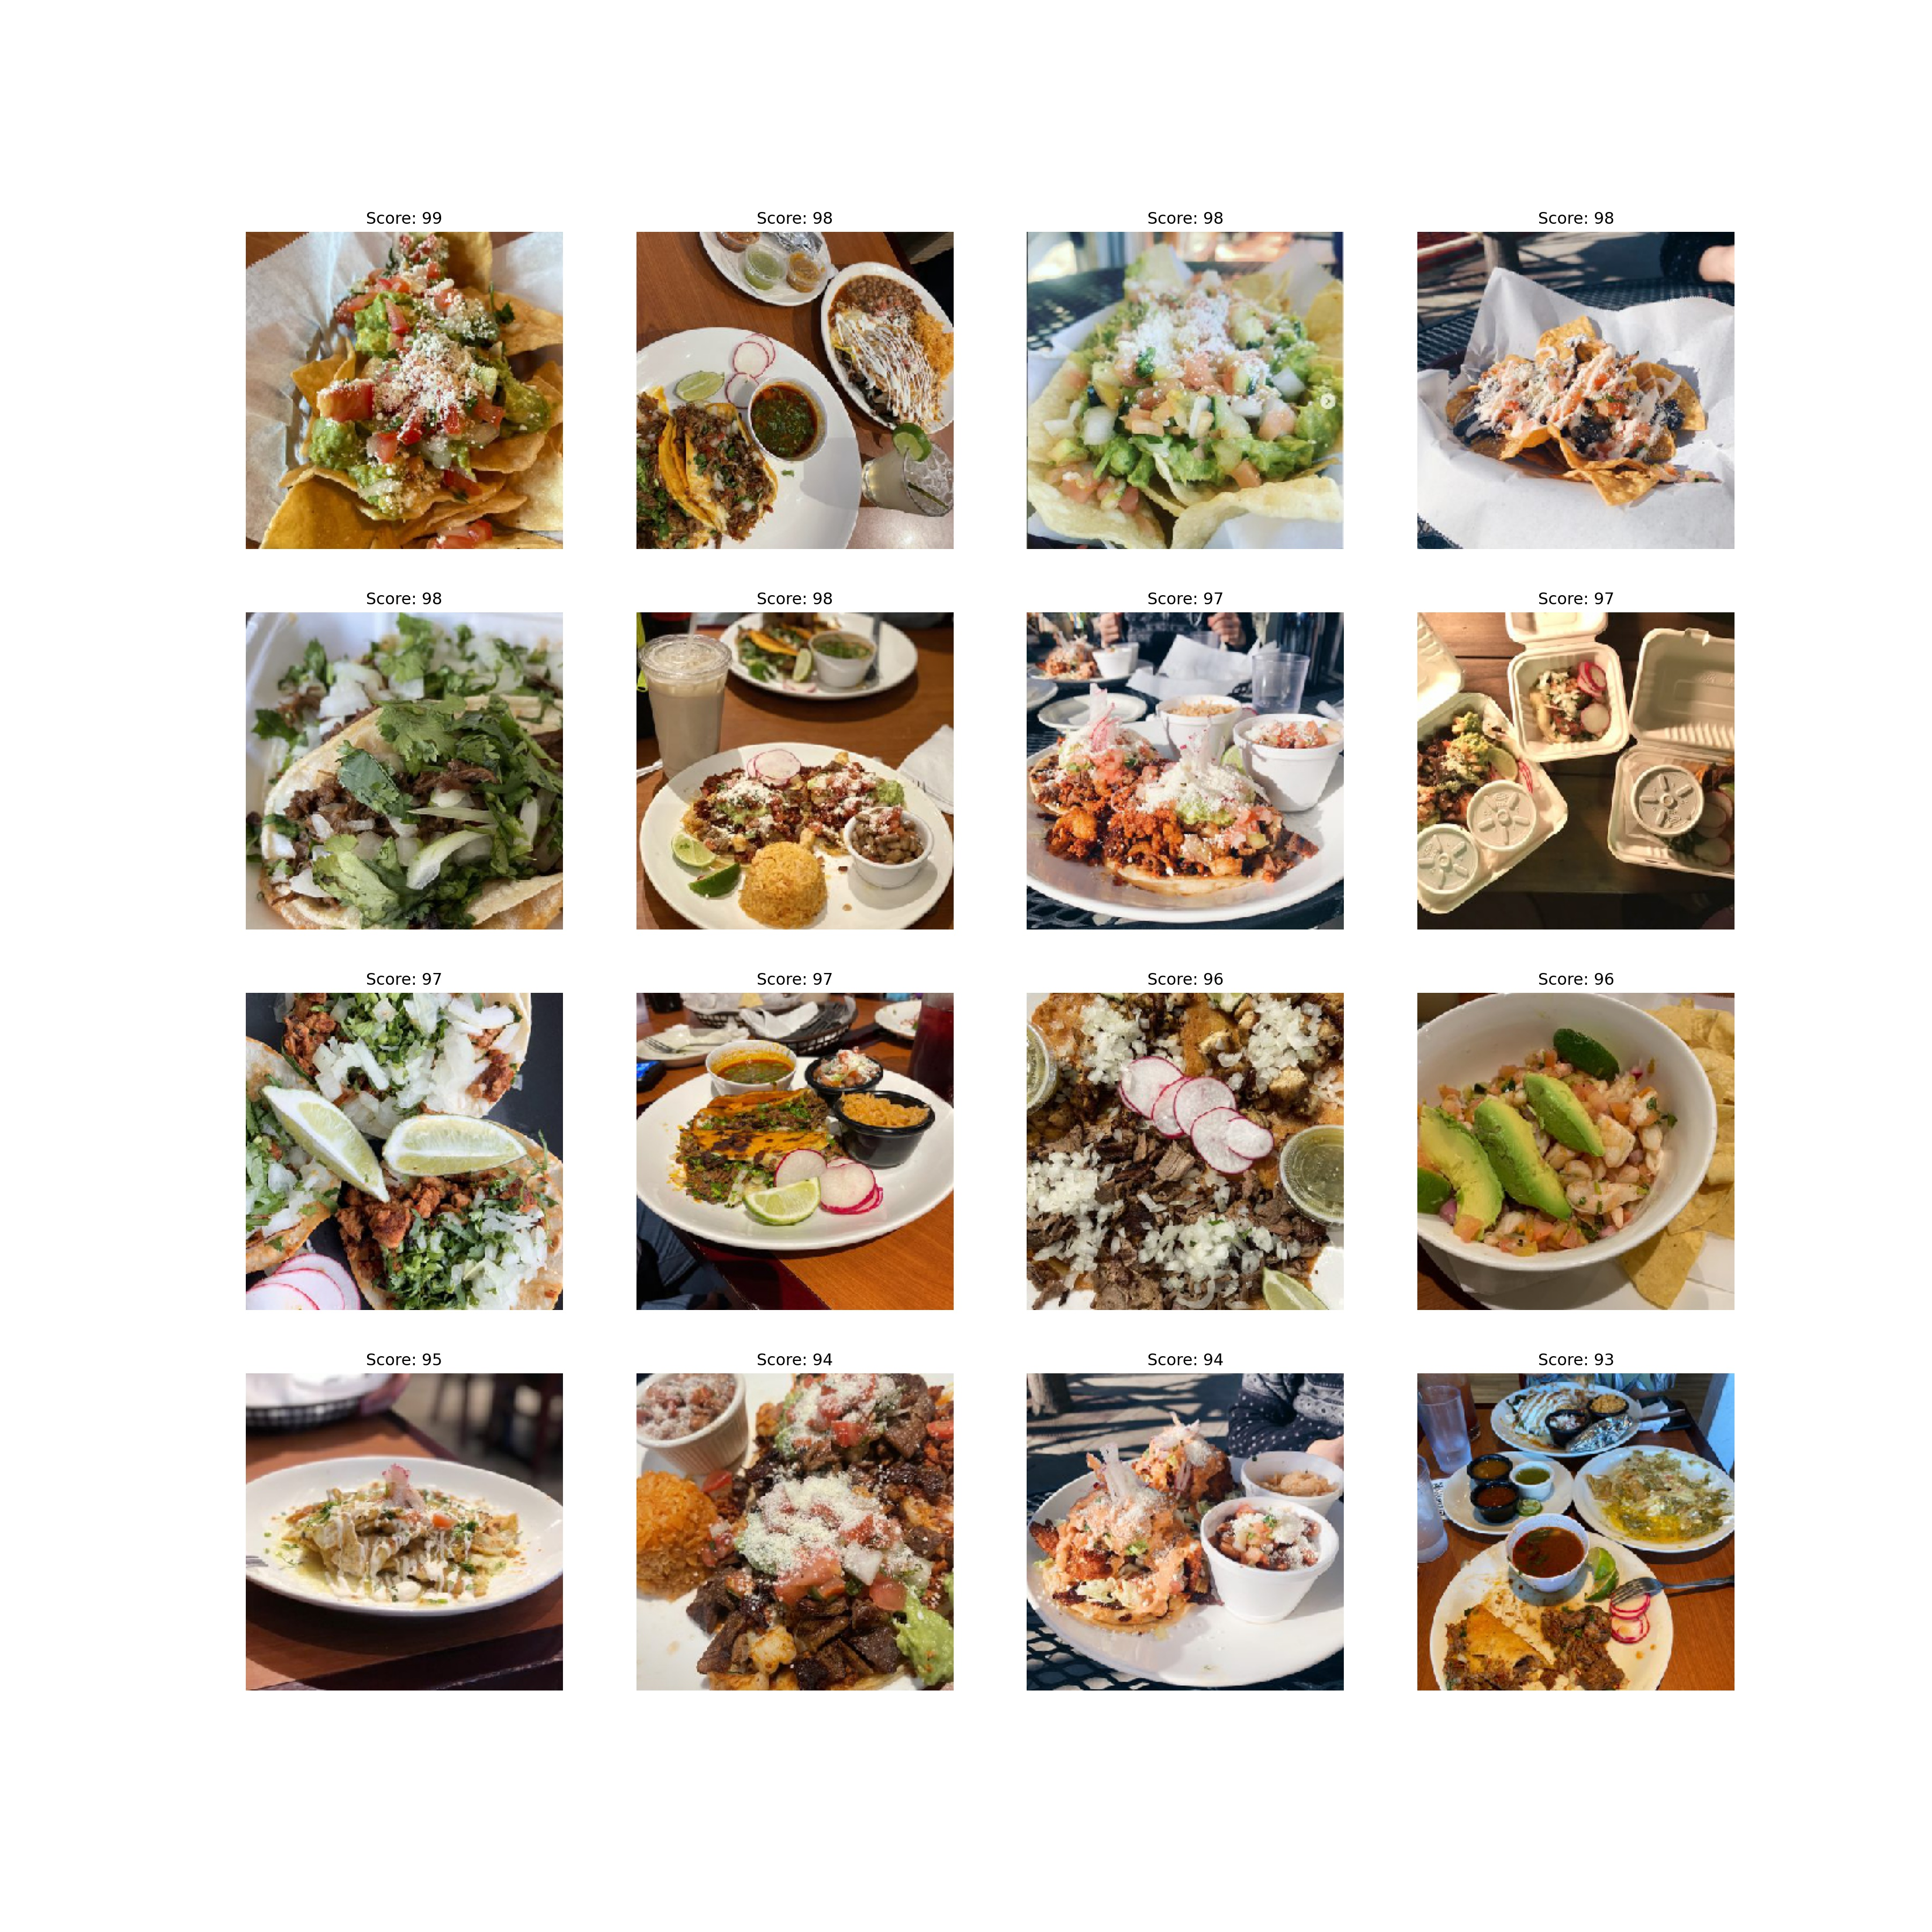
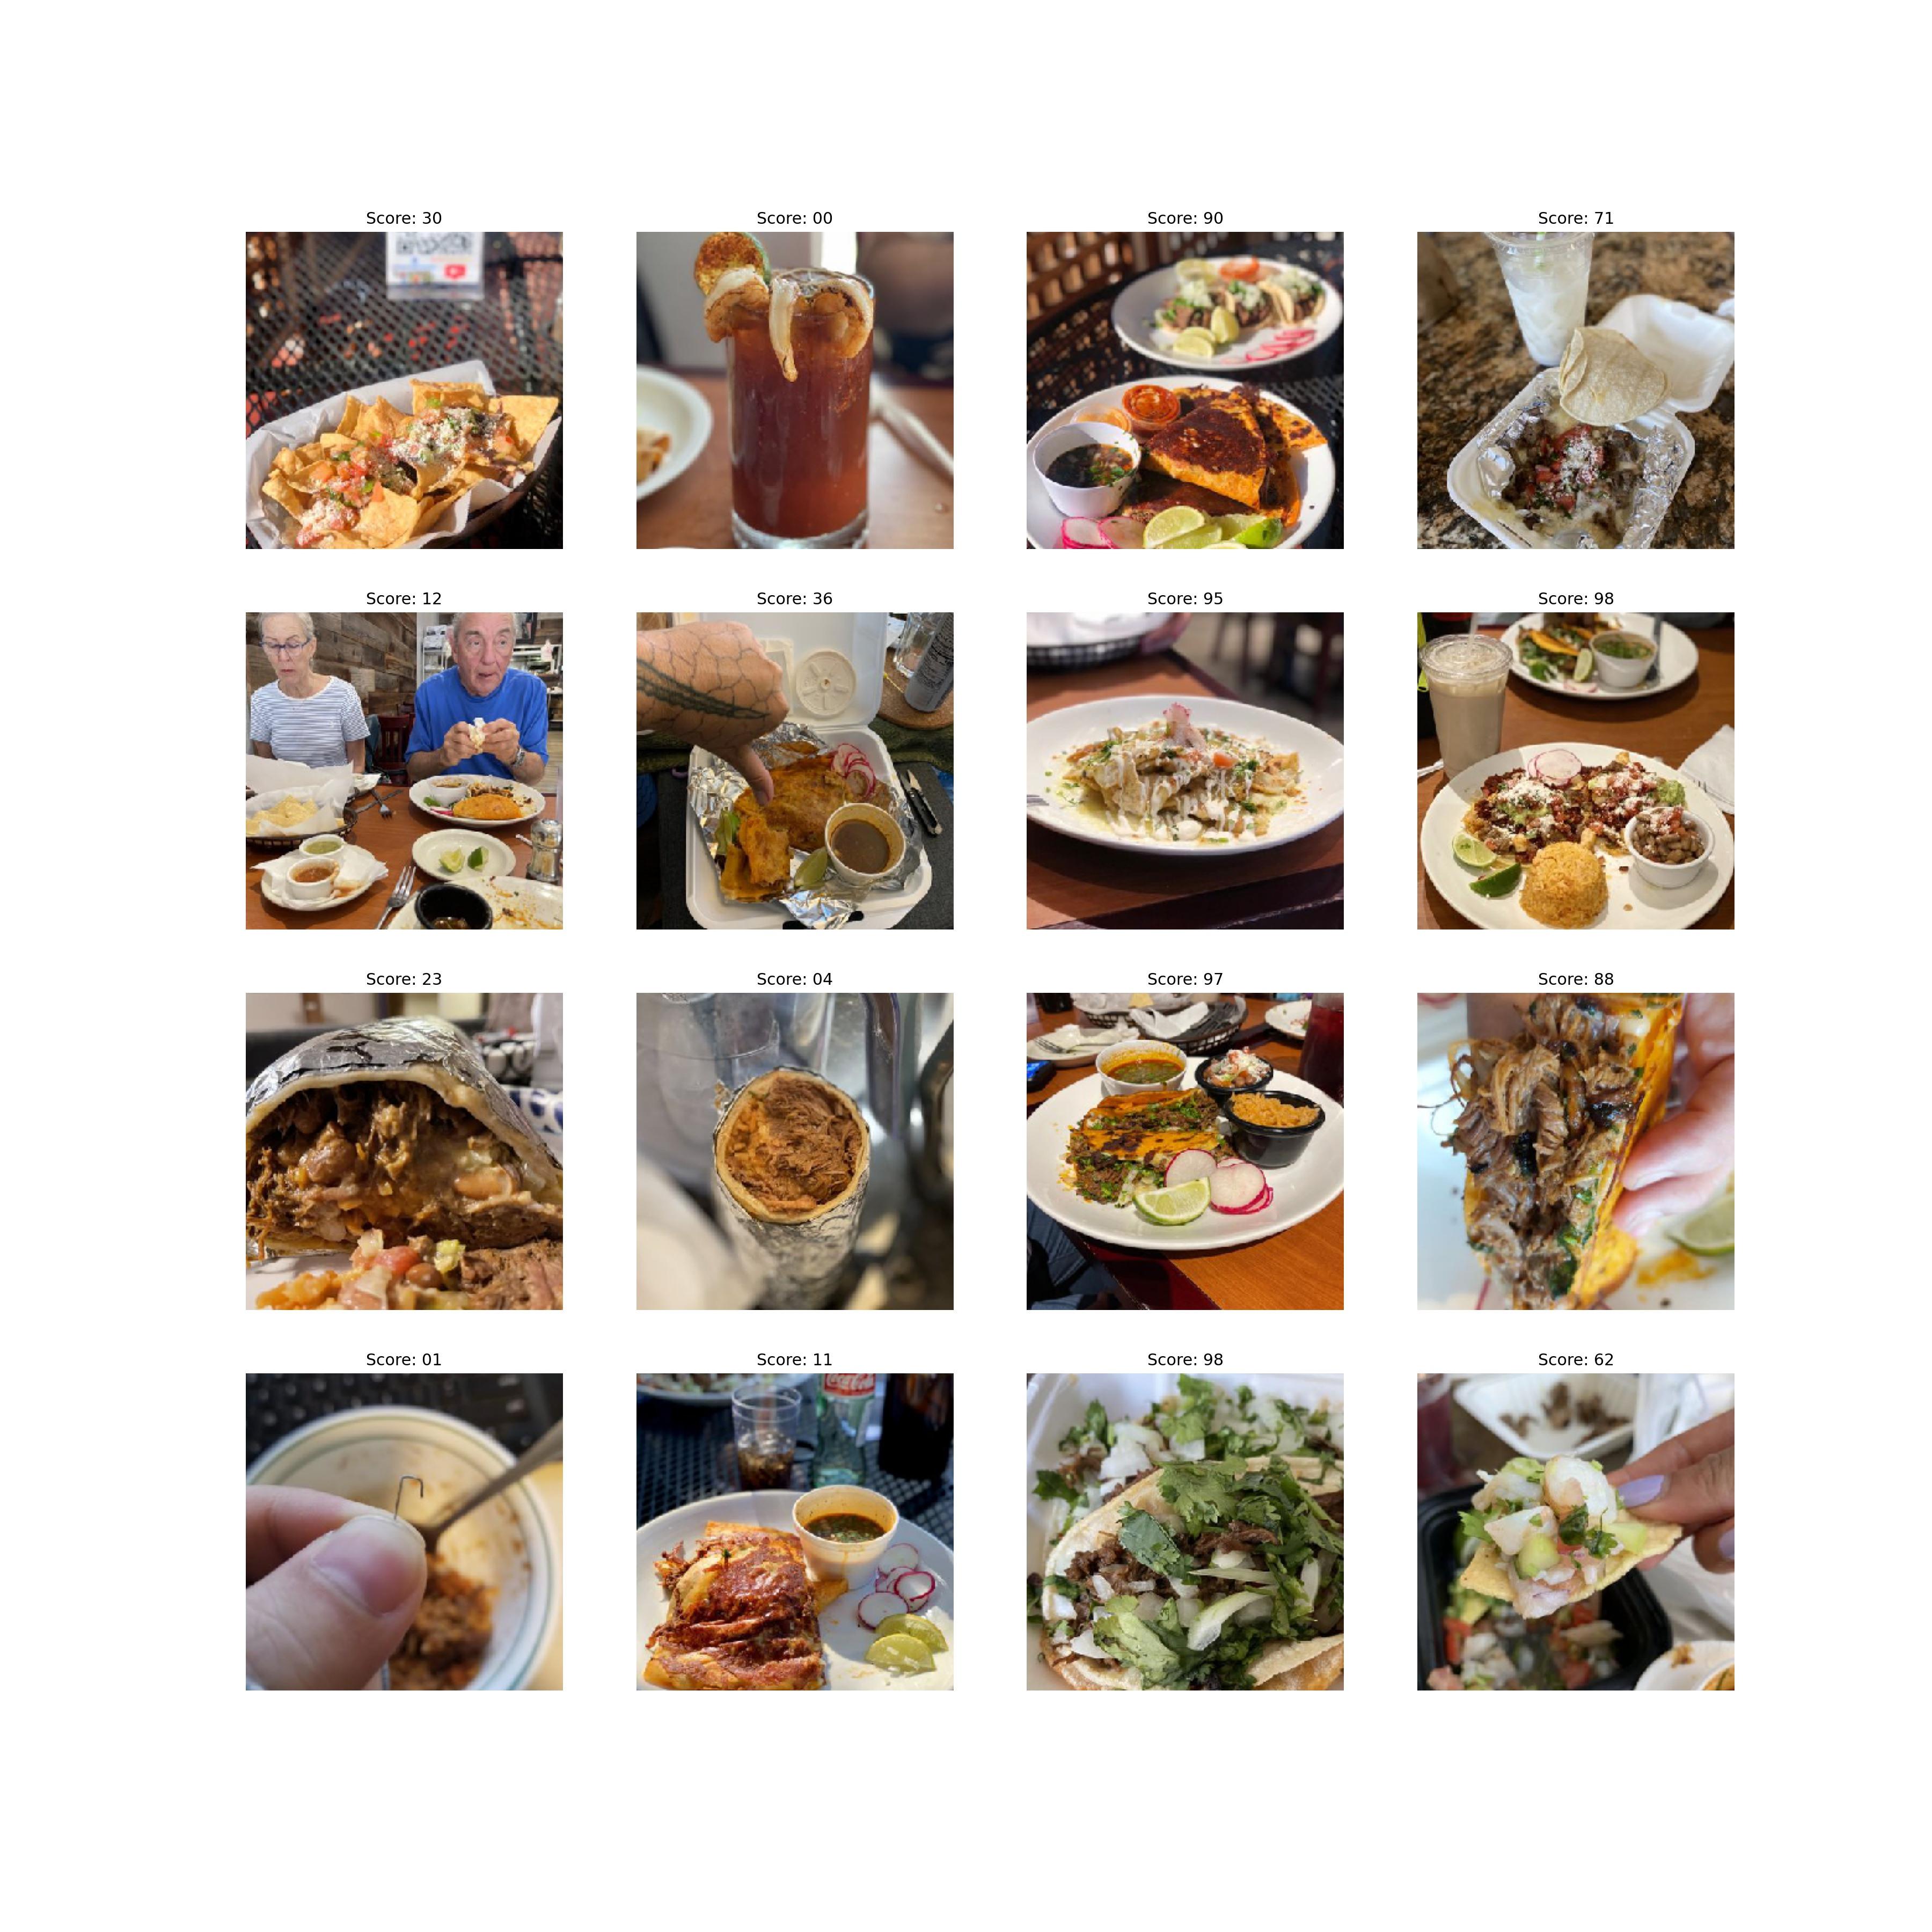
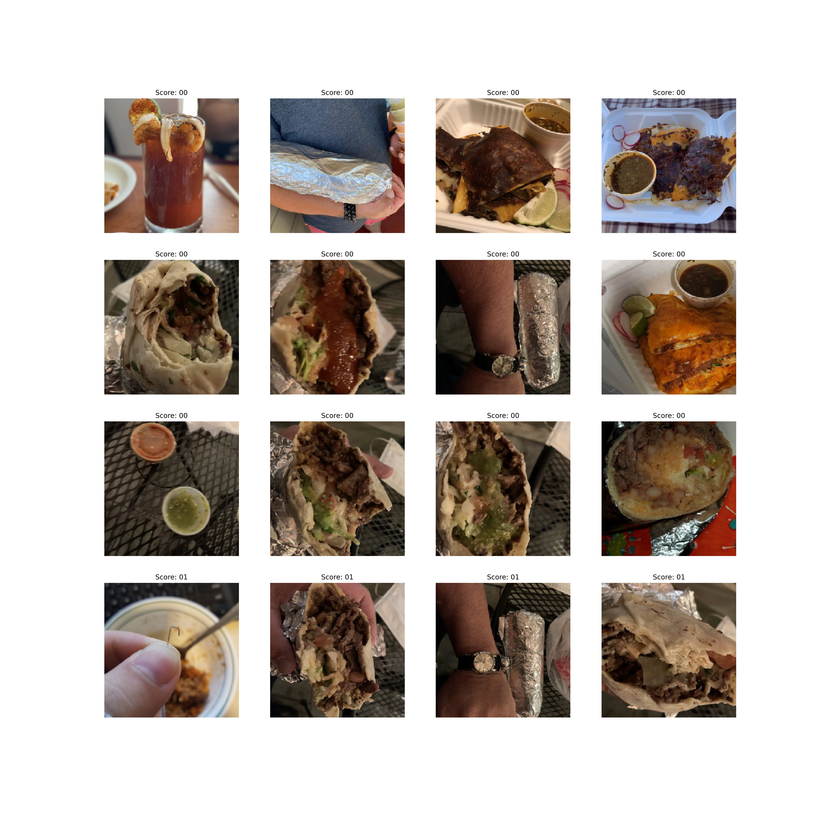
Sorts High quality photos to the top,
Using Machine Learning to sort
Original Gallery order
Sorts poor quality Photos to the bottom
Notes:
Here is an example of a real restaurant gallery that I sorted using machine learning. The grid on the left is the original top of the gallery for one particular restaurant. The top right shows the 15 highest scoring photos and the bottom right shows the 15 lowest scoring photos out of a test set of the first 100 photos on the gallery’s food photos.

Slide 4
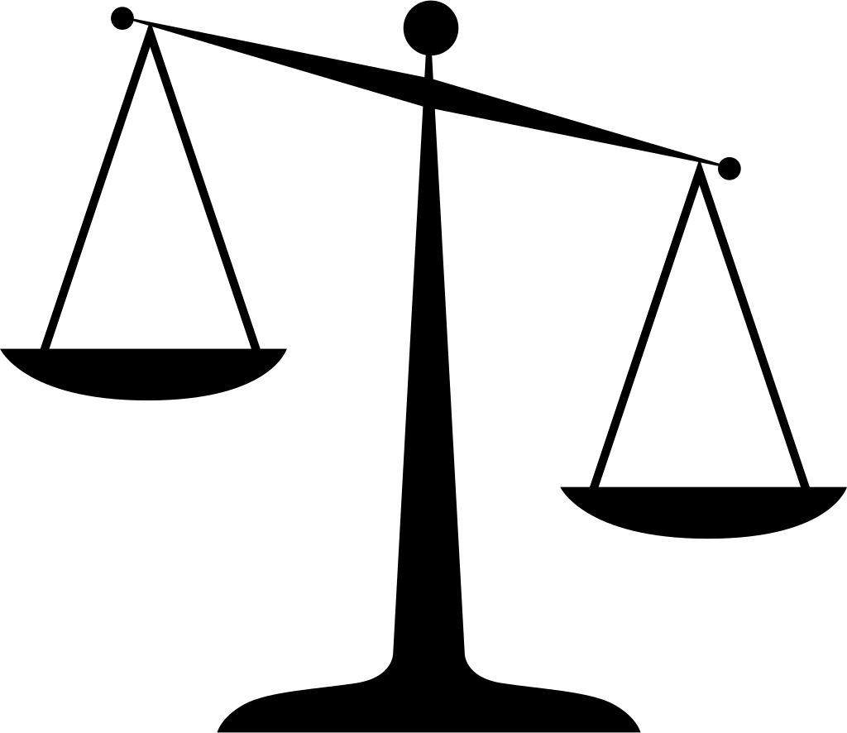

Background
Sources
Notes:
We know that the presence of images increases engagement on social networks. Since the start of covid the use of social media in decision making has gained in importance. Even before covid, restaurant review apps were a very popular way to find new restaurants and this has only increased since then. While there are many competitors in the space: google reviews, instagram, open table, Yelp is well established and it’s revenue is already above pre-covid levels at just over $1 B in 2021.
More about Yelp: Founded in 2004; 100 M unique monthly users; 45% of their customers say they consult Yelp before making a purchase. It’s demographics are evenly distributed but over 1/2 are college educated. Yelp has a $2.5 B market cap,
5.8 million claimed businesses, and 1/4 billion reviews. Is this photo sorting specific to Yelp? No. It could easily applied to other review platforms or other services that could use automated image sorting based on image quality.

Slide 5
Methods
Notes:
For data collection, I started by reviewing what was available through Yelp’s API and pulled a bit of data and also downloaded a research set that Yelp make available to all. But neither of these methods provided a “photo quality” label I could use. So to collect my data, I visited Yelp galleries for various Yelp restaurant pages in California cities and manually downloaded 1400 photos. I used 5 photographic criteria to label 1400 food photos into 2 classes (good and bad). Good and bad refer to the photo quality, not an assessment of the food quality. All photos were from Yelp restaurant pages using the search term “Mexican food” and locations in California.

Slide 6
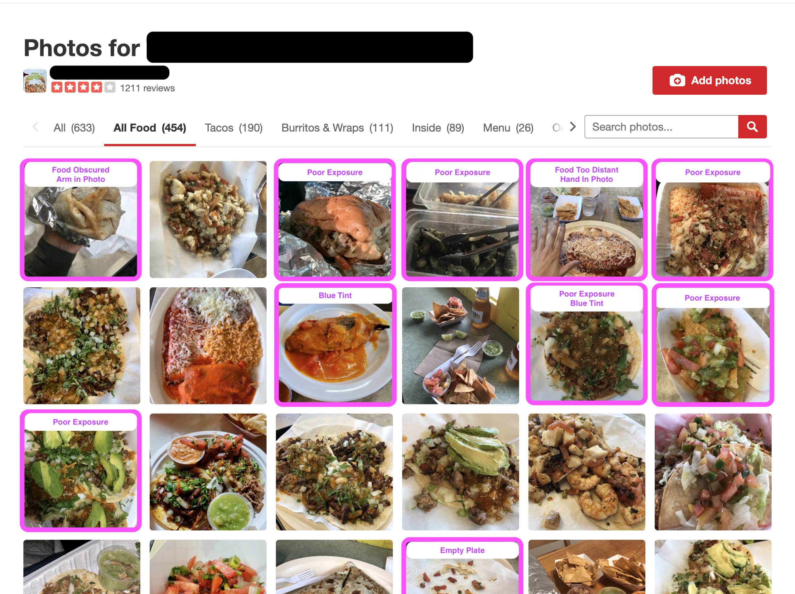
Notes:
Here’s a restaurant 1200 reviews and 4 stars, but it still has lots of poor quality photos on top of the gallery page (under the “All Food” tab to filter out photos of the building, menu, etc.).

Slide 7
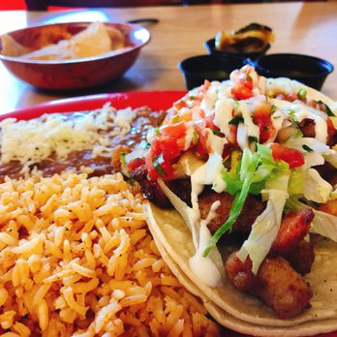
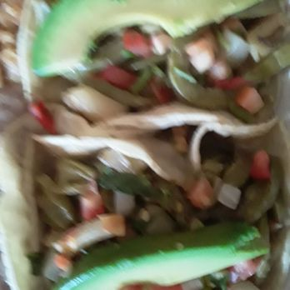
photo criteria
Focus: Subject in focus.
Label: [good]
Label: [bad]
Notes:
Criteria 1: Focus
The subject needs to be in focus, background blur is nice, but not required.

Slide 8
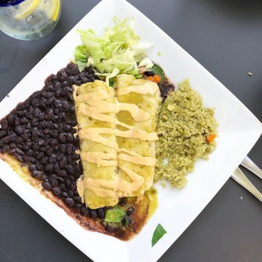
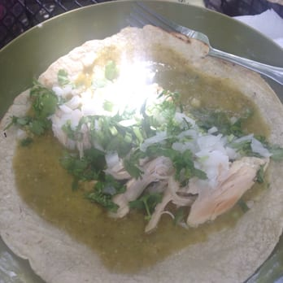
photo criteria
Focus: Subject in focus.
Exposure: Even
Label: [good]
Label: [bad]
Notes:
Criteria 2: Exposure
Exposure had to be even across the image with most pixels in the mid-range of possible light values. Extreme light or dark patches were considered bad.

Slide 9
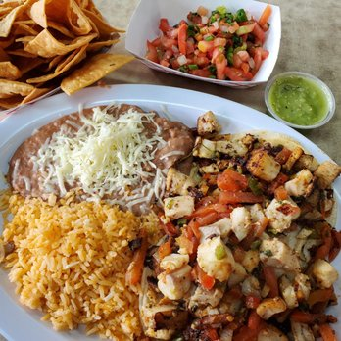
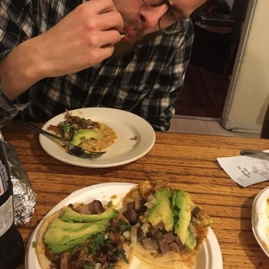
photo criteria
Focus
Exposure
Subject
Label: [good]
Label: [bad]
Notes:
Criteria 3: Subject
The subject had to be the food; the whole plate or a single item was fine. No people, body parts, or extraneous objects should take away attention from the subject.

Slide 10
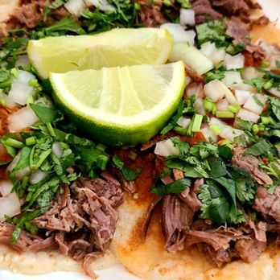
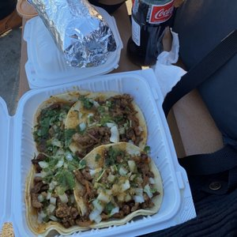
photo criteria
Focus
Exposure
Subject
Color
Label: [good]
Label: [bad]
Notes:
Criteria 4: Color
Color needed to be neutral to warm in tone and not extremely saturated. Cool blue tints or other odd colorings were considered poor quality.

Slide 11
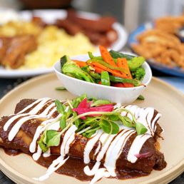
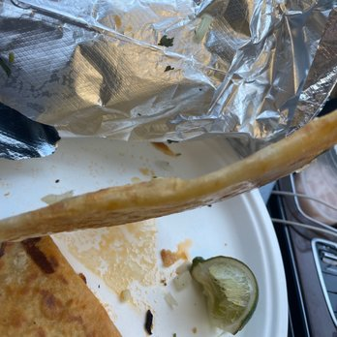
photo criteria
Focus
Exposure
Subject
Color
Pattern / Composition
Label: [good]
Label: [bad]
Notes:
Criteria 5: Pattern/Composition
Pattern includes a lot of “rules of thumb” that are pleasing to the eye: rule of 3rds, golden proportion, rule of odds, lines of symmetry. Half-eaten burritos, empty plates, and photos that were chaotic in composition were labeled bad photos.
Again, this project is not about documenting poor quality food. While it’s true that app users may want to see some pictures of poor quality food so they can rule out visiting a business, it’s likely many would still like the option to sort by photo quality.

Slide 12
data visualization

Slide 13
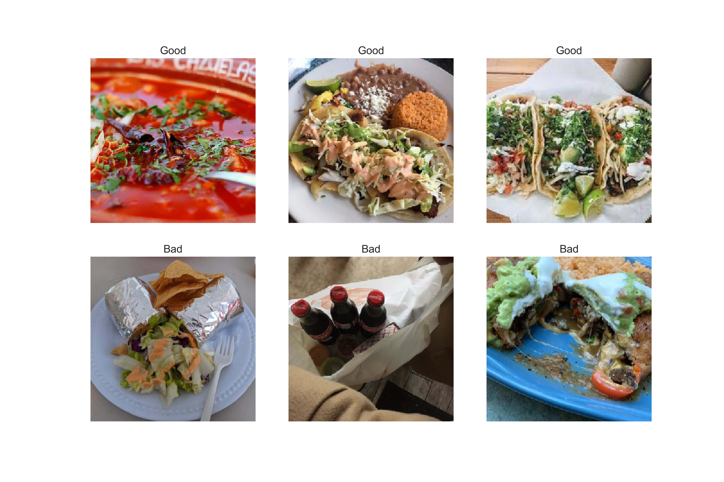
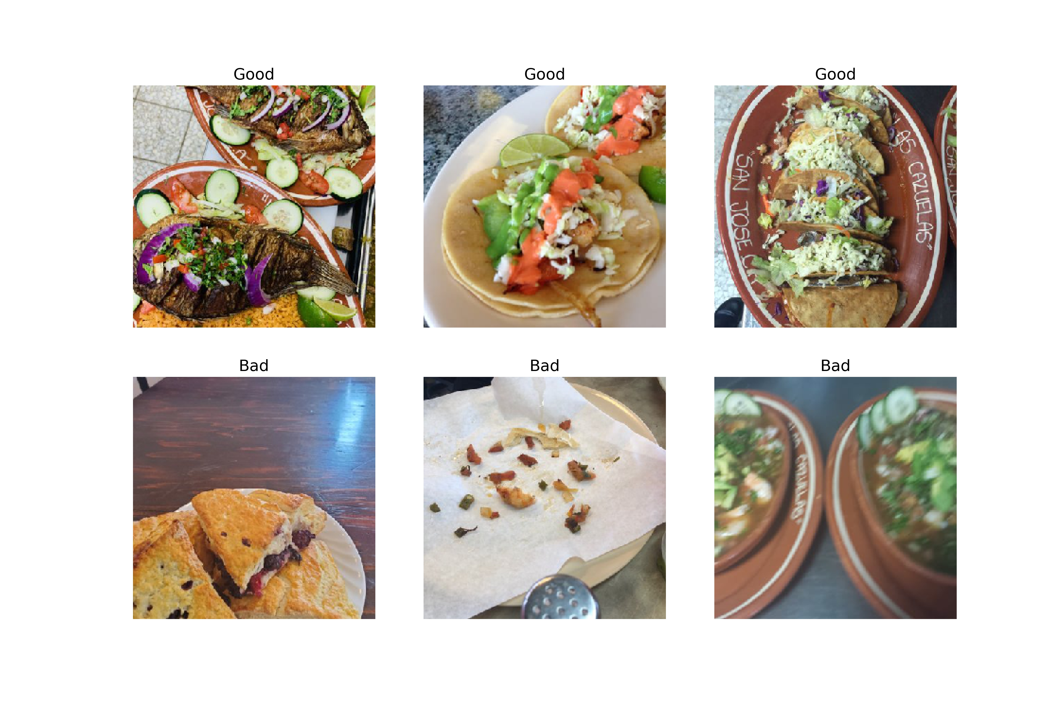
Notes:
Here’s an example of the criteria manually applied to label photos as either good or bad in image quality.

Slide 14
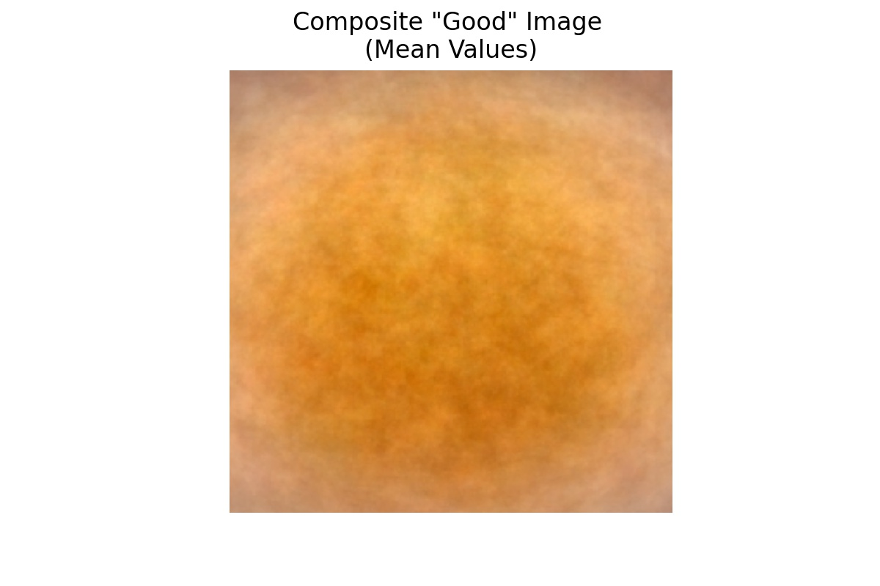
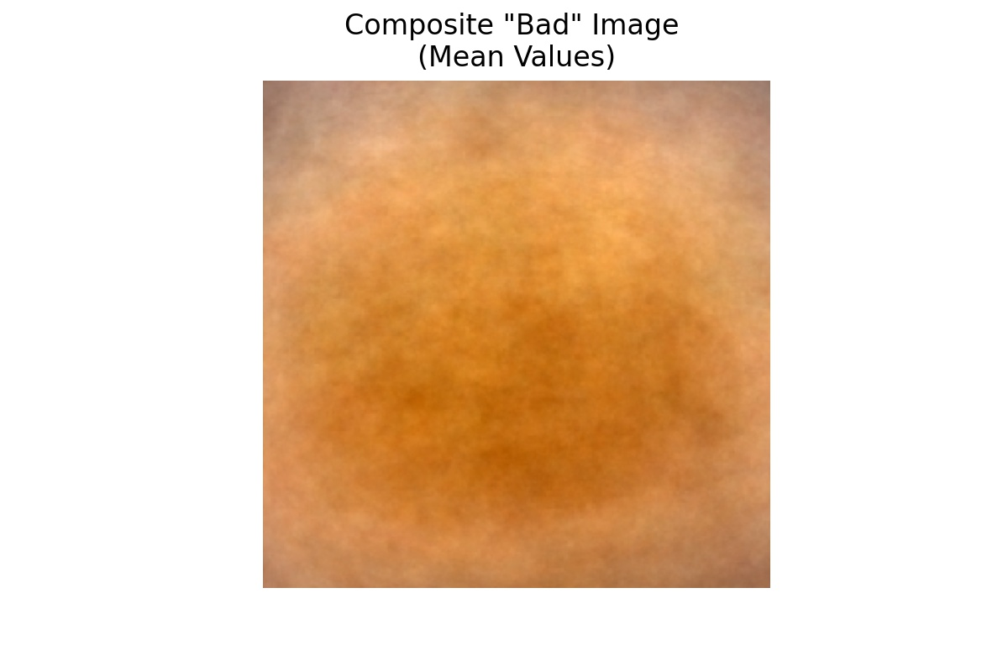
Data Visualization
Composite image for each class (mean values)
Notes:
This is a composite average image taken by combining all photos from each class (good/bad). Just a bit darker overall in the bad class, and a bit more vignetting (darker corners; common problem in low exposure photos).

Slide 15
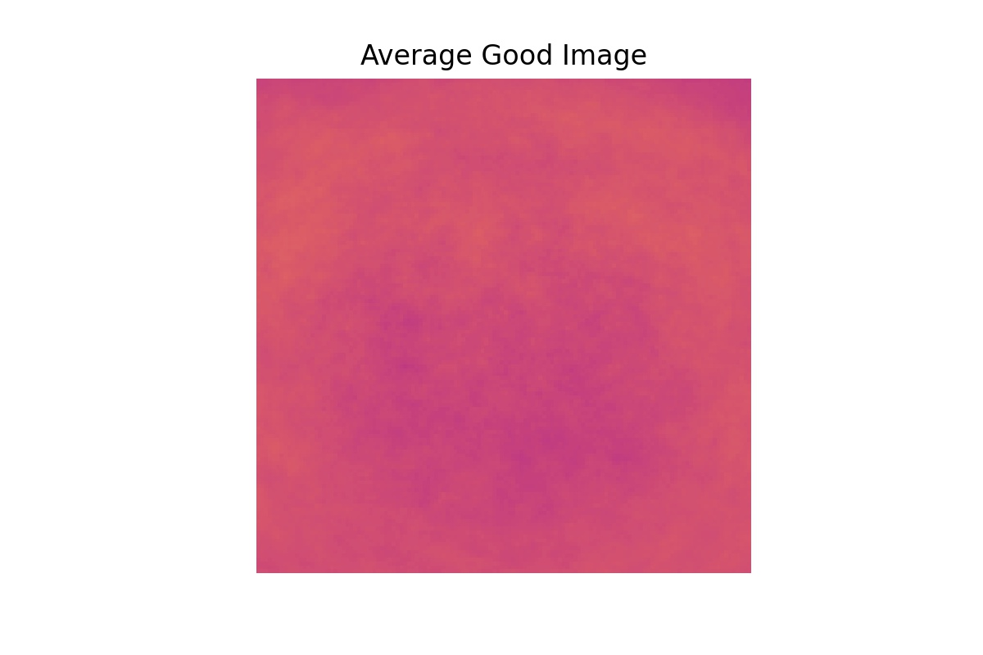
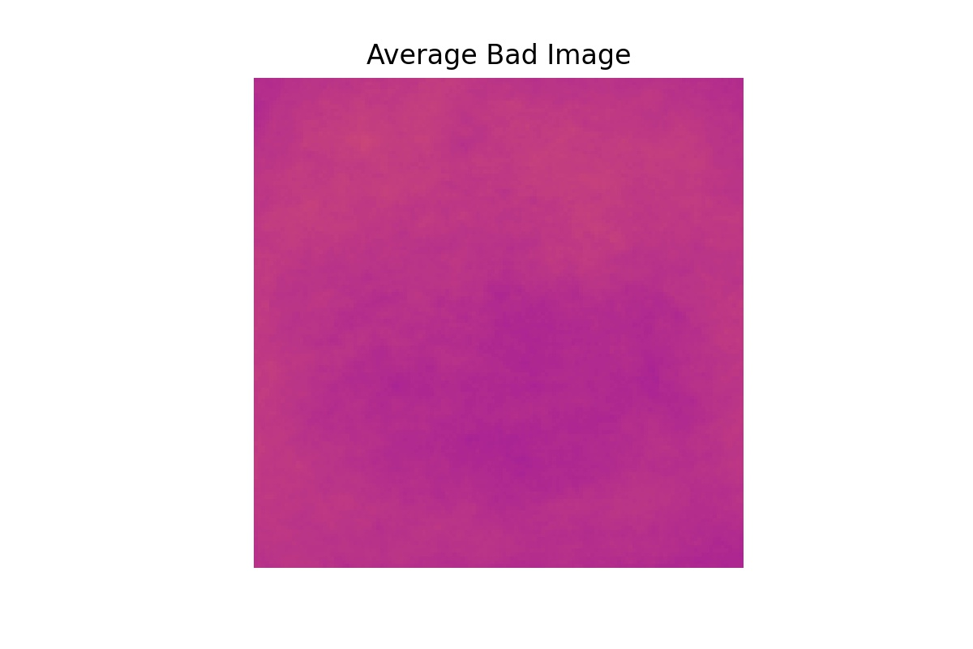
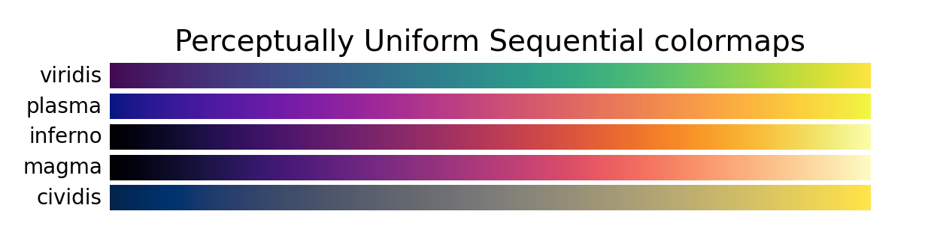
Data Visualization
Average Grayscale Image Per Class
Notes:
Here’s the same averaged composite images in a perceptually uniform colormap from Matplotlib called “plasma”. There are several others. Hopefully this makes seeing the difference a little easier.

Slide 16
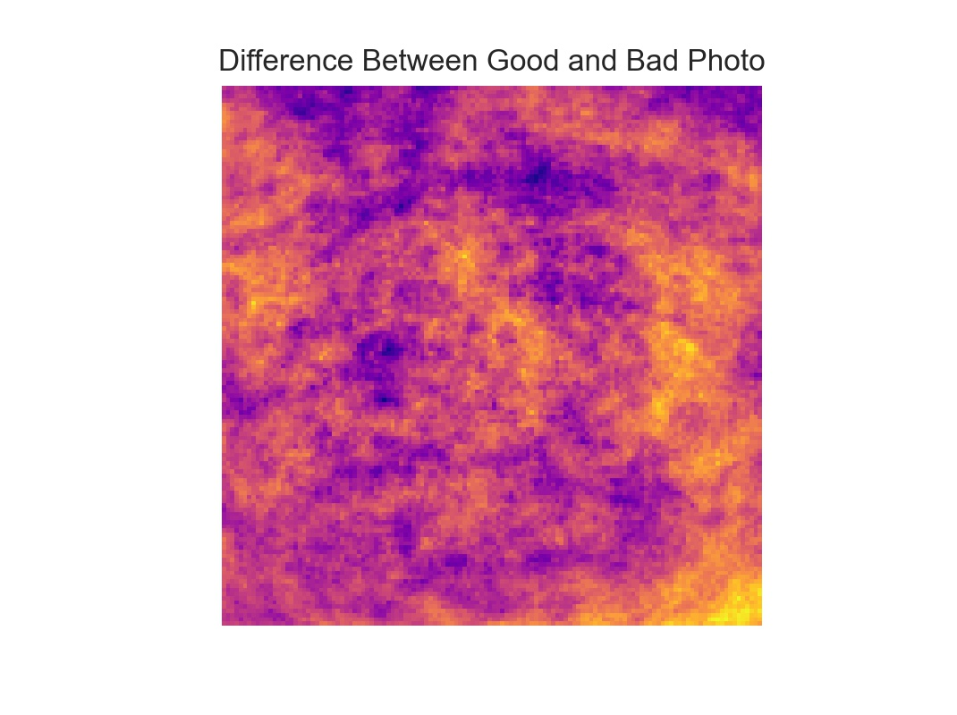
Data Visualization
Contrast Image (Difference Between Average “Good” Image And Average “Bad” Image)
Notes:
This contrast image is basically subtraction applied to the previous 2 images (average good composite and average bad composite). You can see some concentric forms that probably represent plates. Corners are high contrast, probably indicating that bad images have more vignetting than good images.

Slide 17
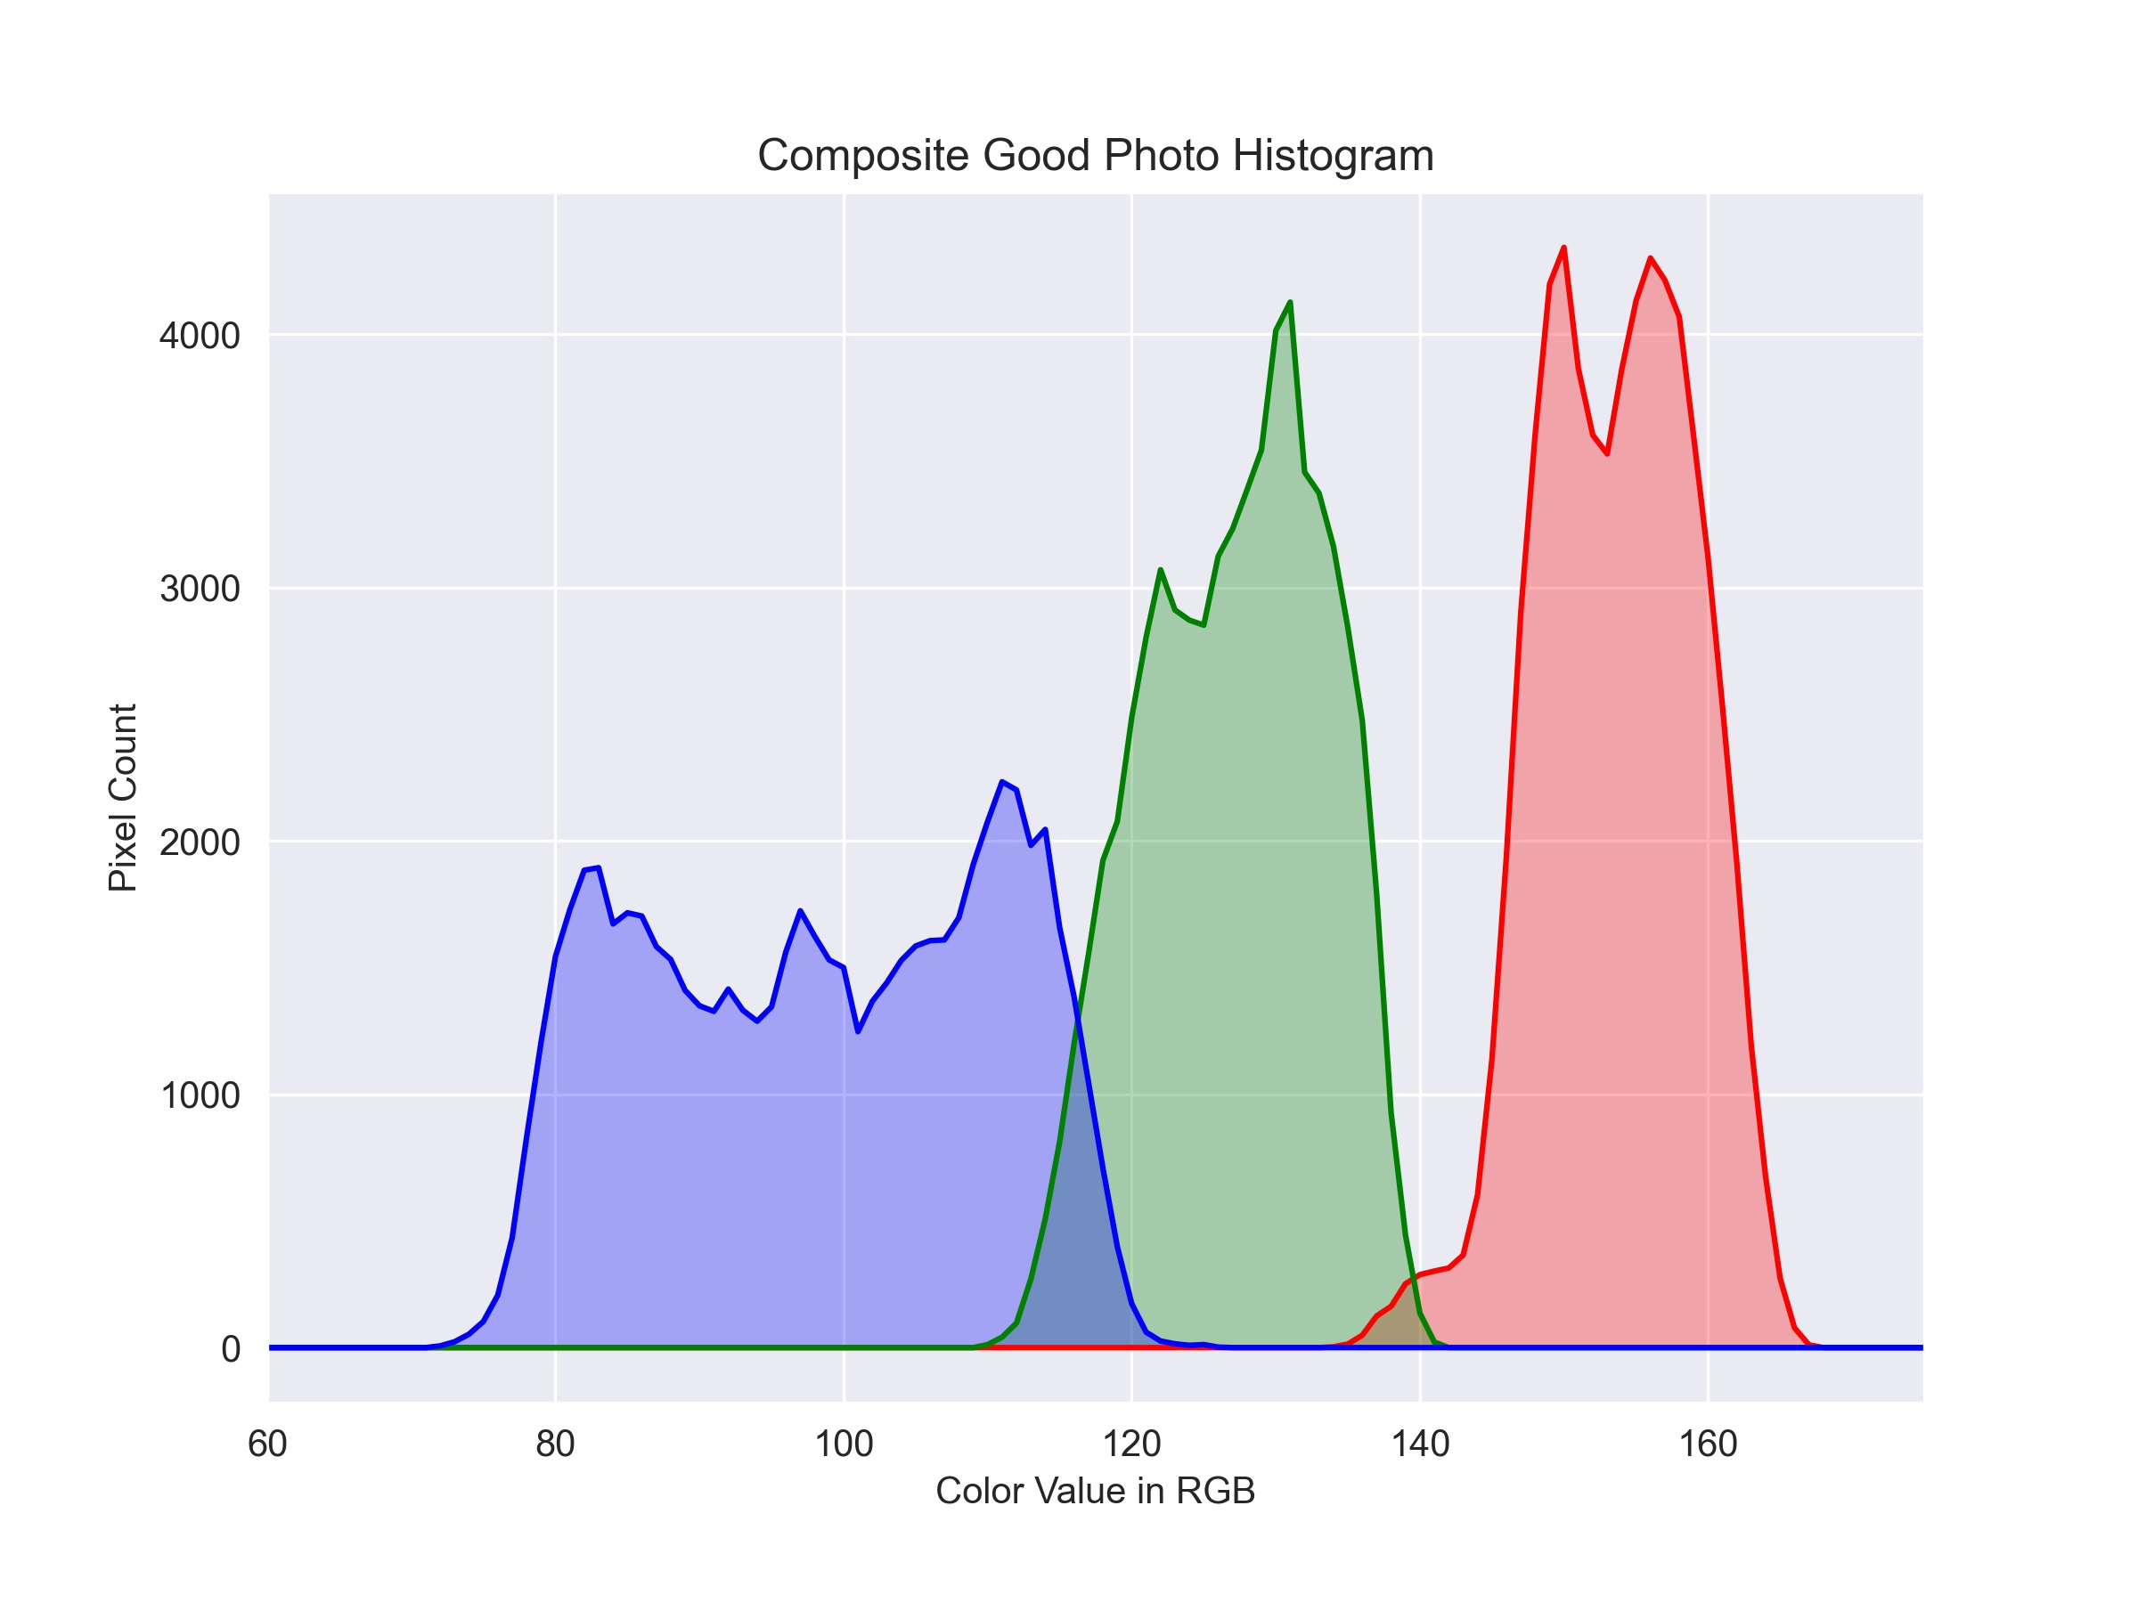
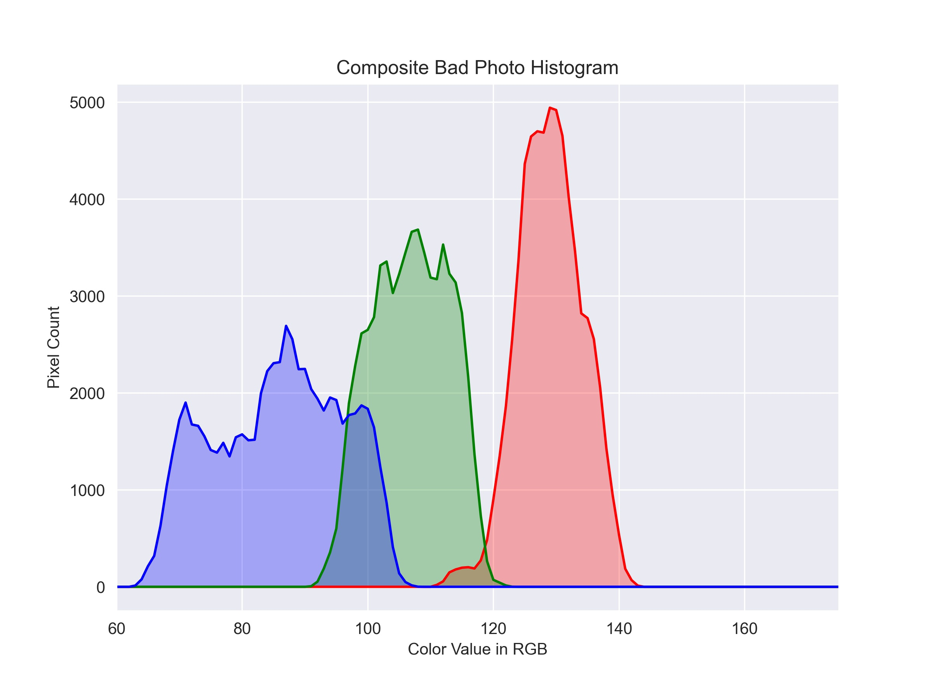
Data Visualization
Composite Histograms for Each Class
Notes:
In these histograms, taken from the good and bad average composites respectively, you can see the average good composite covers a wider array of brightness values (x axis) and more bright values (right side of x axis is brighter). In general, good photos tended to be lighter. A common problem in indoor photography is not having enough light or having poor quality light such as fluorescent bulbs that cast a tint that isn’t neutral.

Slide 18
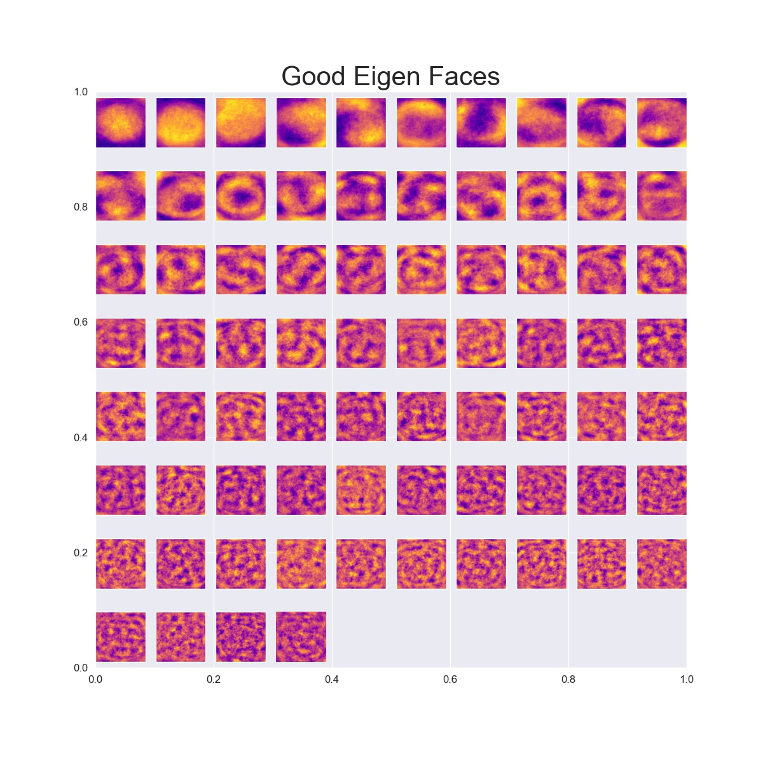
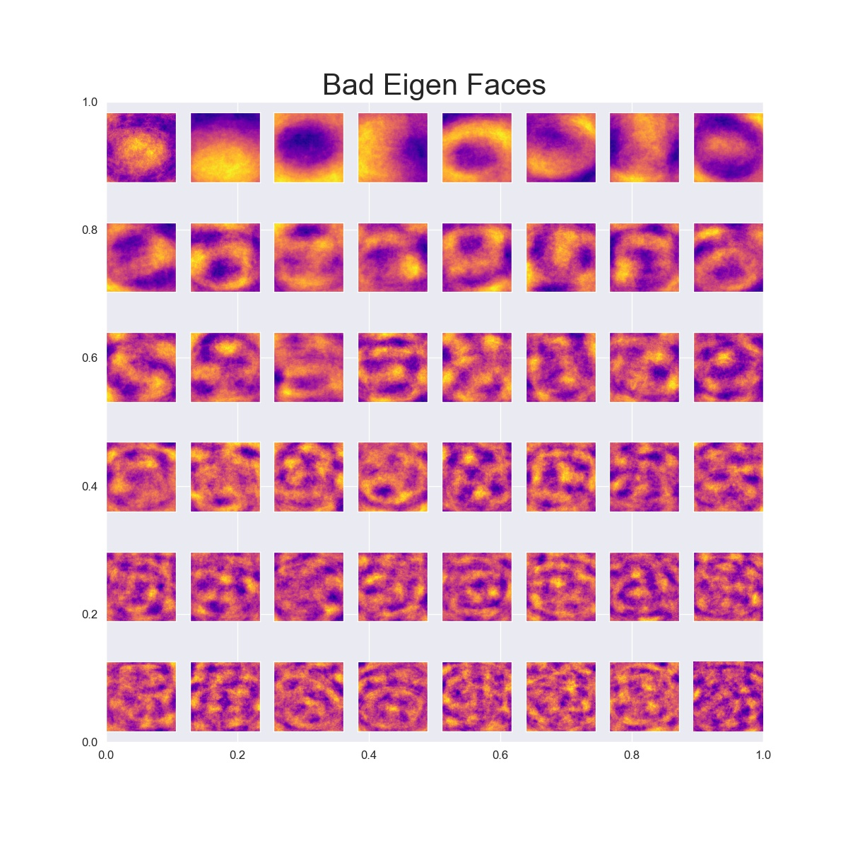
Data Visualization
Principle Components Analysis
Makes Composites of Each Class That Explain 70% of the Variance
Sometimes Called “Eigen Faces”; used in facial recognition research.
Notes:
Conclusions:
-Having a dish helps - this goes back to the idea of pattern (something to frame the food)
-Finer texture may help
-Appears to be more variability in the good photos than in bad (might be they’re “blown out”)

Slide 19
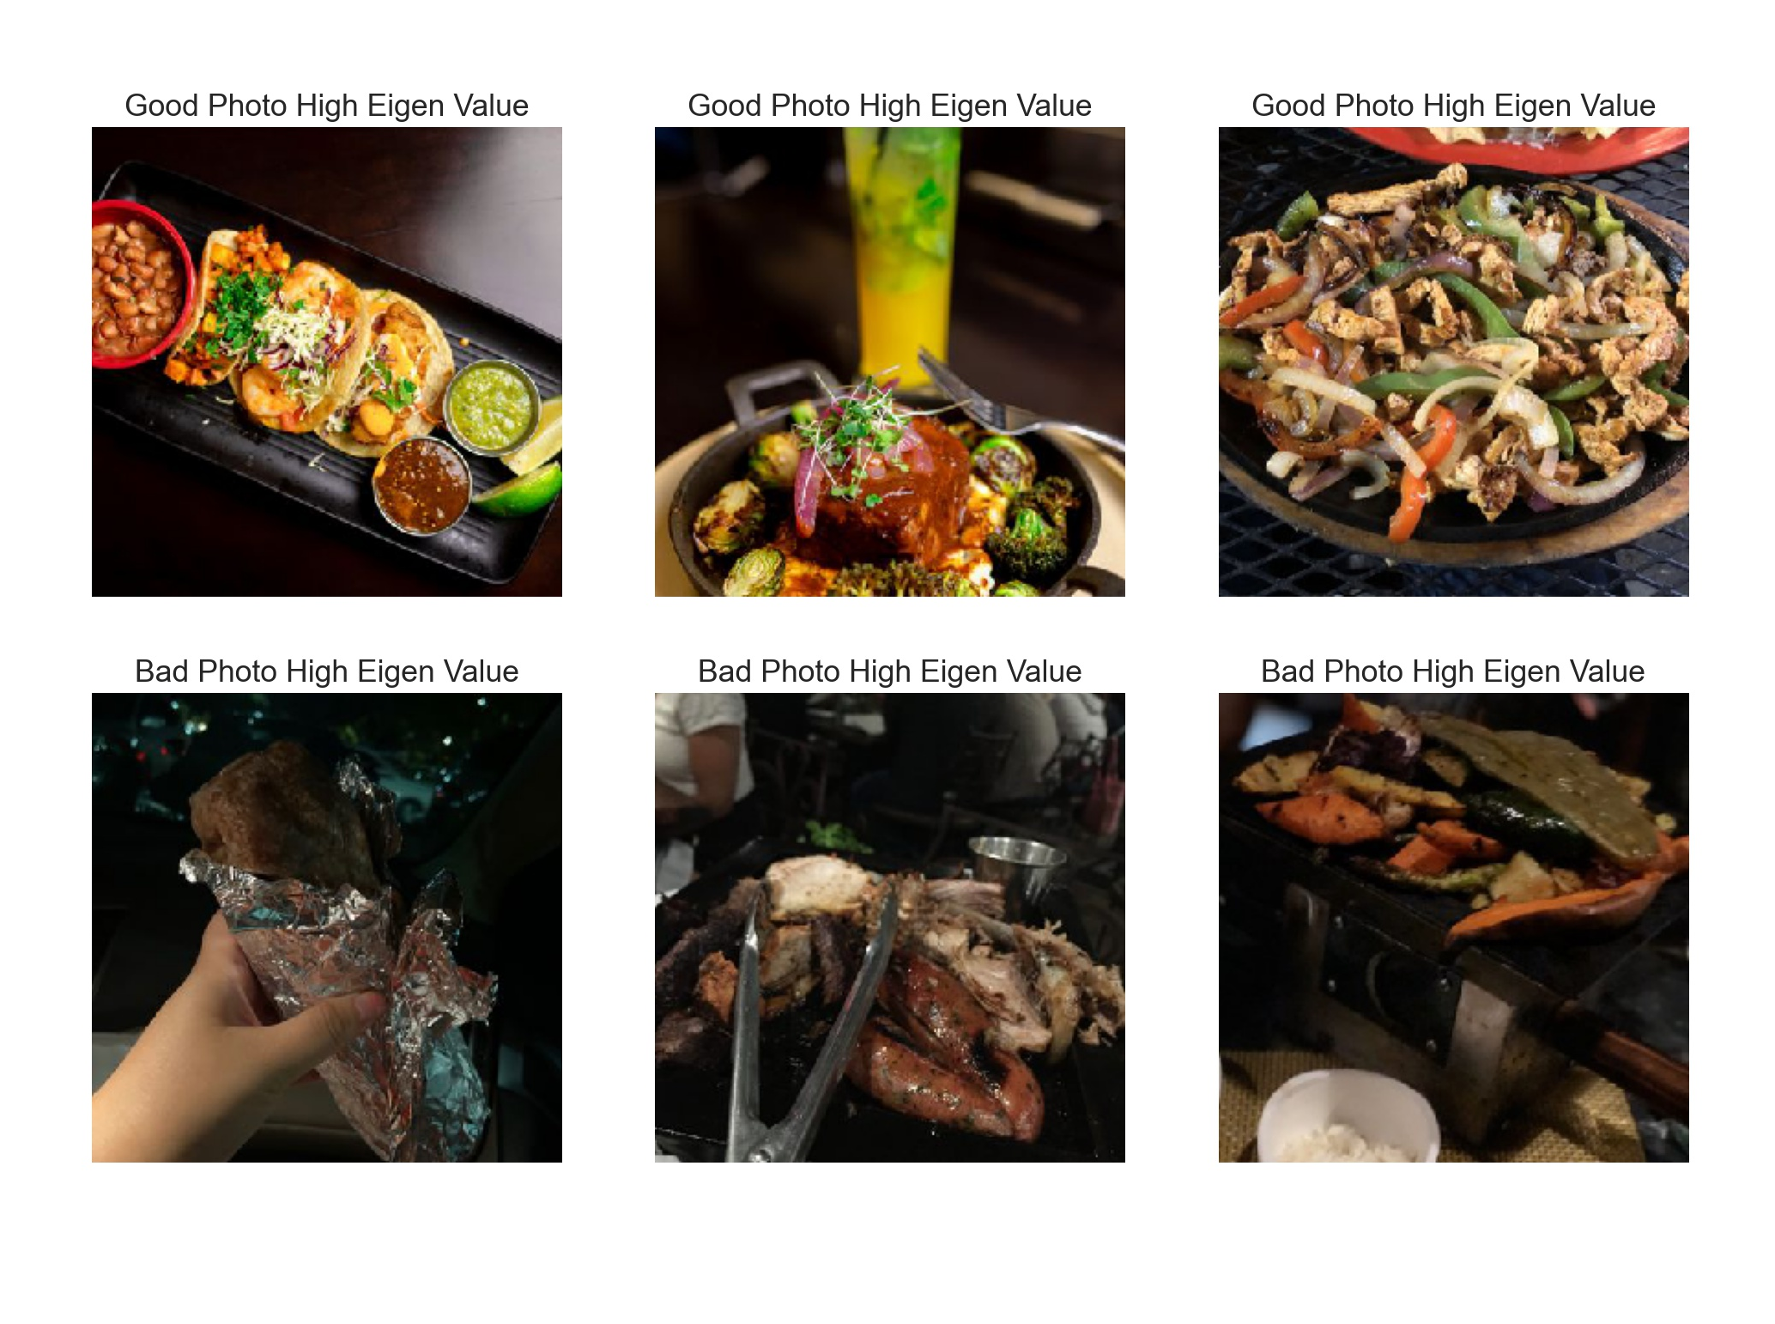
Notes:
Looking at individual images with high good photo Eigen values or high bad photo Eigen values, It appears the best photos had bright, sharp, centered images of food, with smooth, plain, backgrounds. The worst images were very underexposed, blurry, and/or presented non-food objects.

Slide 20
Modeling

Slide 21
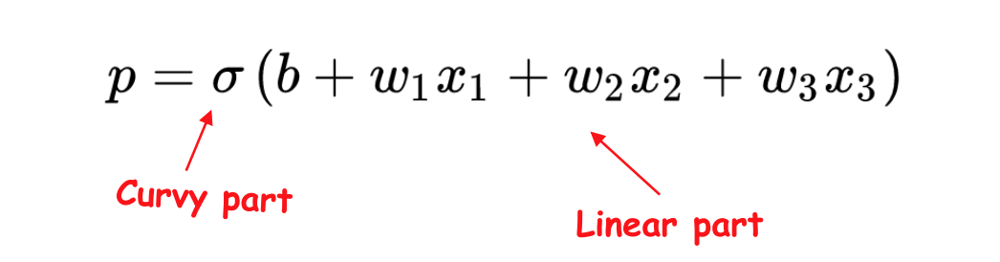
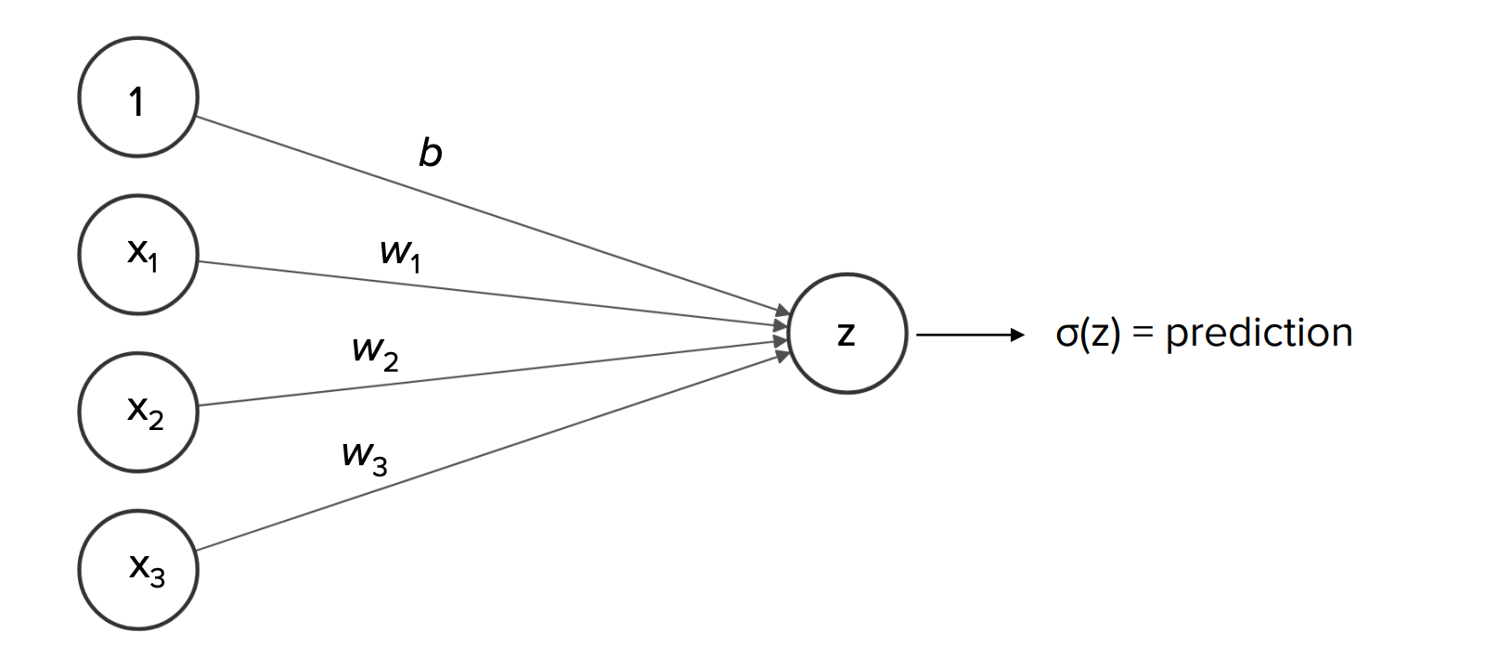

Convolutional Neural Nets (CNN)
Modeling Technique
What are they?
CNNs are some of the best classifiers for images
Two Methods Used. Two Models for EACH:
CNN from Scratch (Model 1, Model 2)
CNN with Transfer Learning (Model 3, Model 4)
Source
Notes:
CNN 1 NNs are Basically a complexed stack of logistic regressions. Each is passed through layers and transformed (affected by the other regressions). The linear part of the log reg allows our data to impact our result and the curvy part (sigma) lets us learn more complex, non-linear relationships btwn x & y. More layers can let us learn even more complex relationships (in theory). In a CNN, instead of looking at one long string array of pixels, we look at small grids of pixels (represented by matrices) that help us pick out shapes and edges. Low-level convolutions pick up small features and higher-level convolutions learn how those features fit together

Slide 22
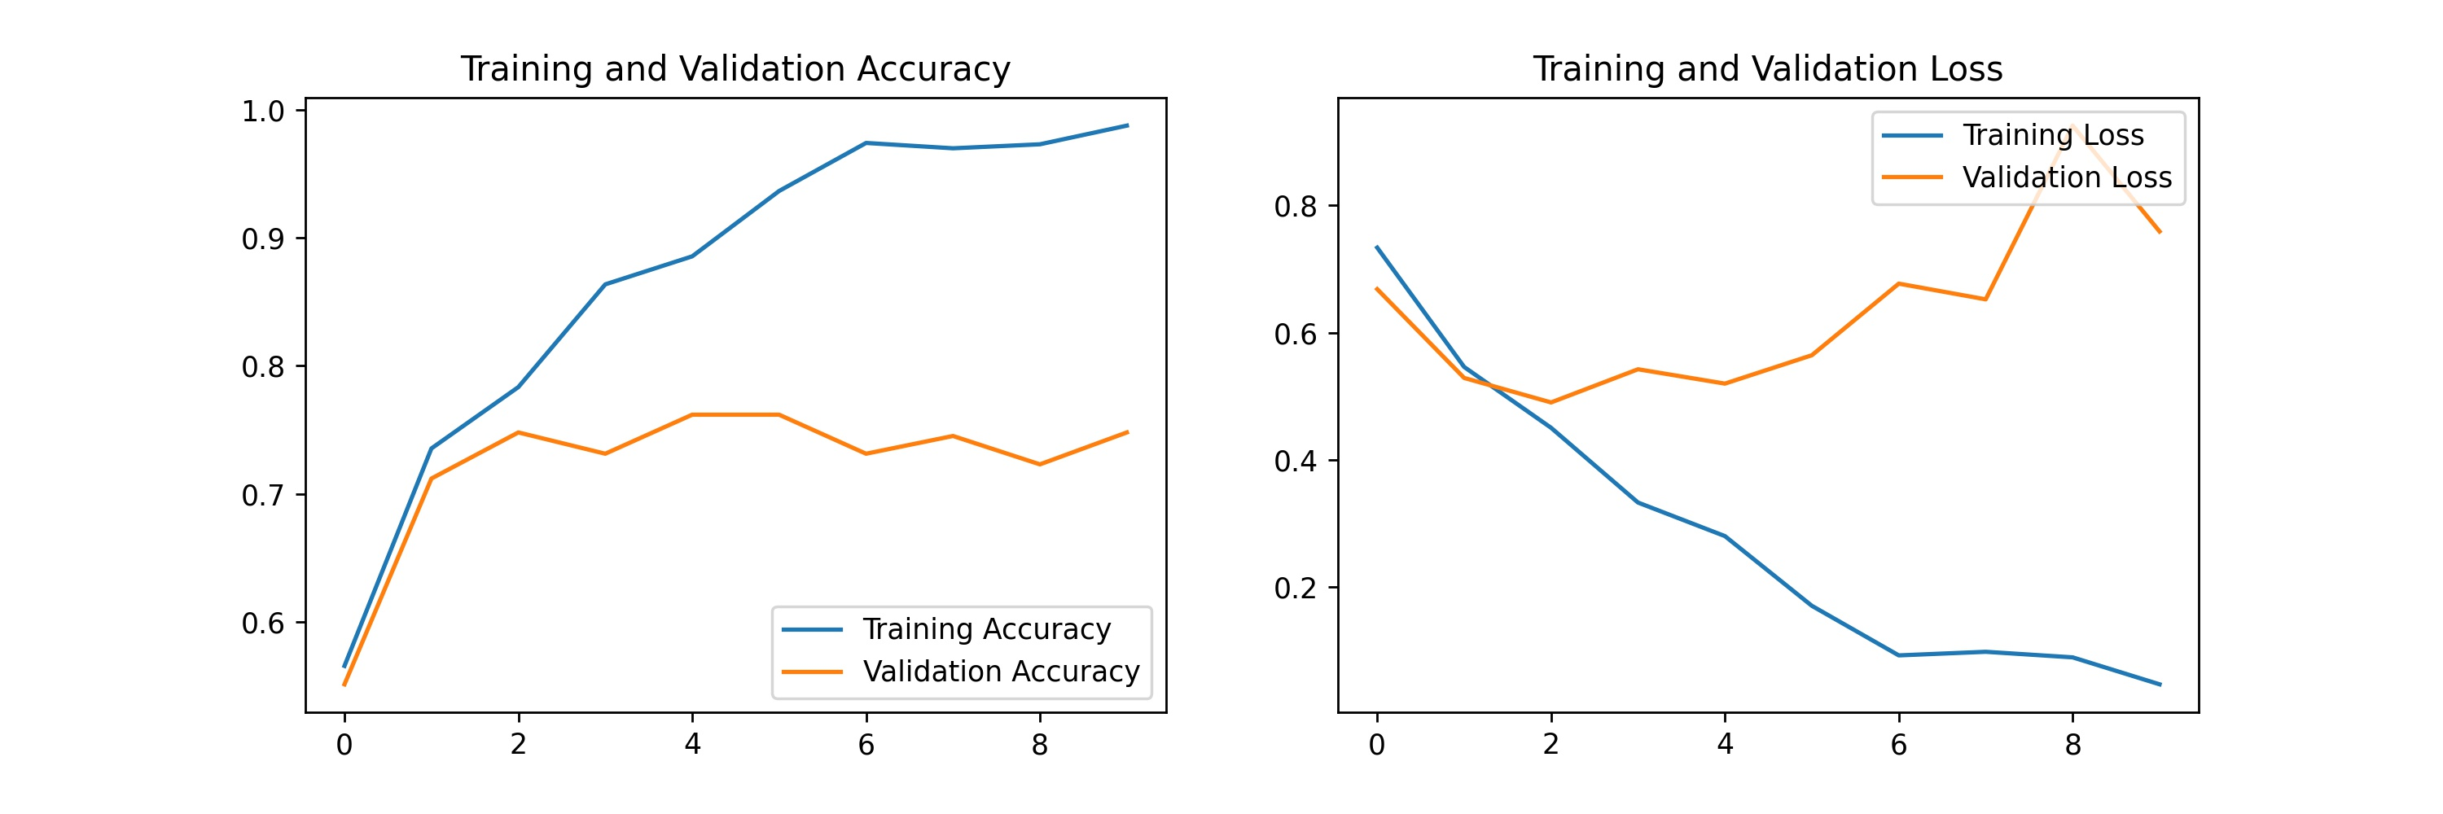
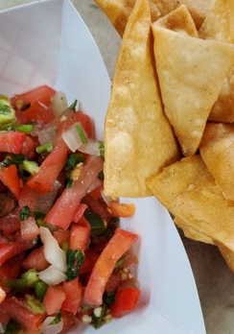
Model 1:
CNN Image classifier from scratch
Model 1: 76% ACC
Batch size: 16, Image size: 256x256
Model: "sequential_5"
_________________________________________________________________
Layer (type) Output Shape Param #
=================================================================
rescaling_8 (Rescaling) (None, 256, 256, 3) 0
conv2d_15 (Conv2D) (None, 256, 256, 16) 448
max_pooling2d_15 (MaxPoolin (None, 128, 128, 16) 0
g2D)
conv2d_16 (Conv2D) (None, 128, 128, 32) 4640
max_pooling2d_16 (MaxPoolin (None, 64, 64, 32) 0
g2D)
conv2d_17 (Conv2D) (None, 64, 64, 64) 18496
max_pooling2d_17 (MaxPoolin (None, 32, 32, 64) 0
g2D)
flatten_5 (Flatten) (None, 65536) 0
dense_10 (Dense) (None, 128) 8388736
dense_11 (Dense) (None, 1) 129
=================================================================
Total params: 8,412,449
Trainable params: 8,412,449
Non-trainable params: 0

Slide 23
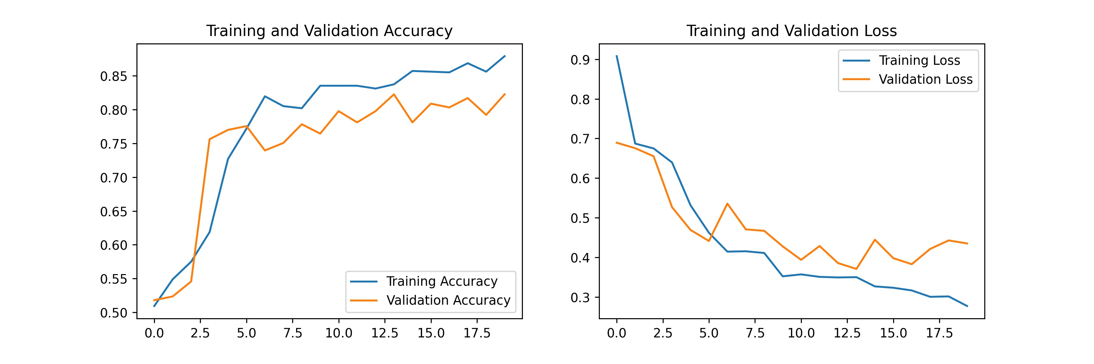
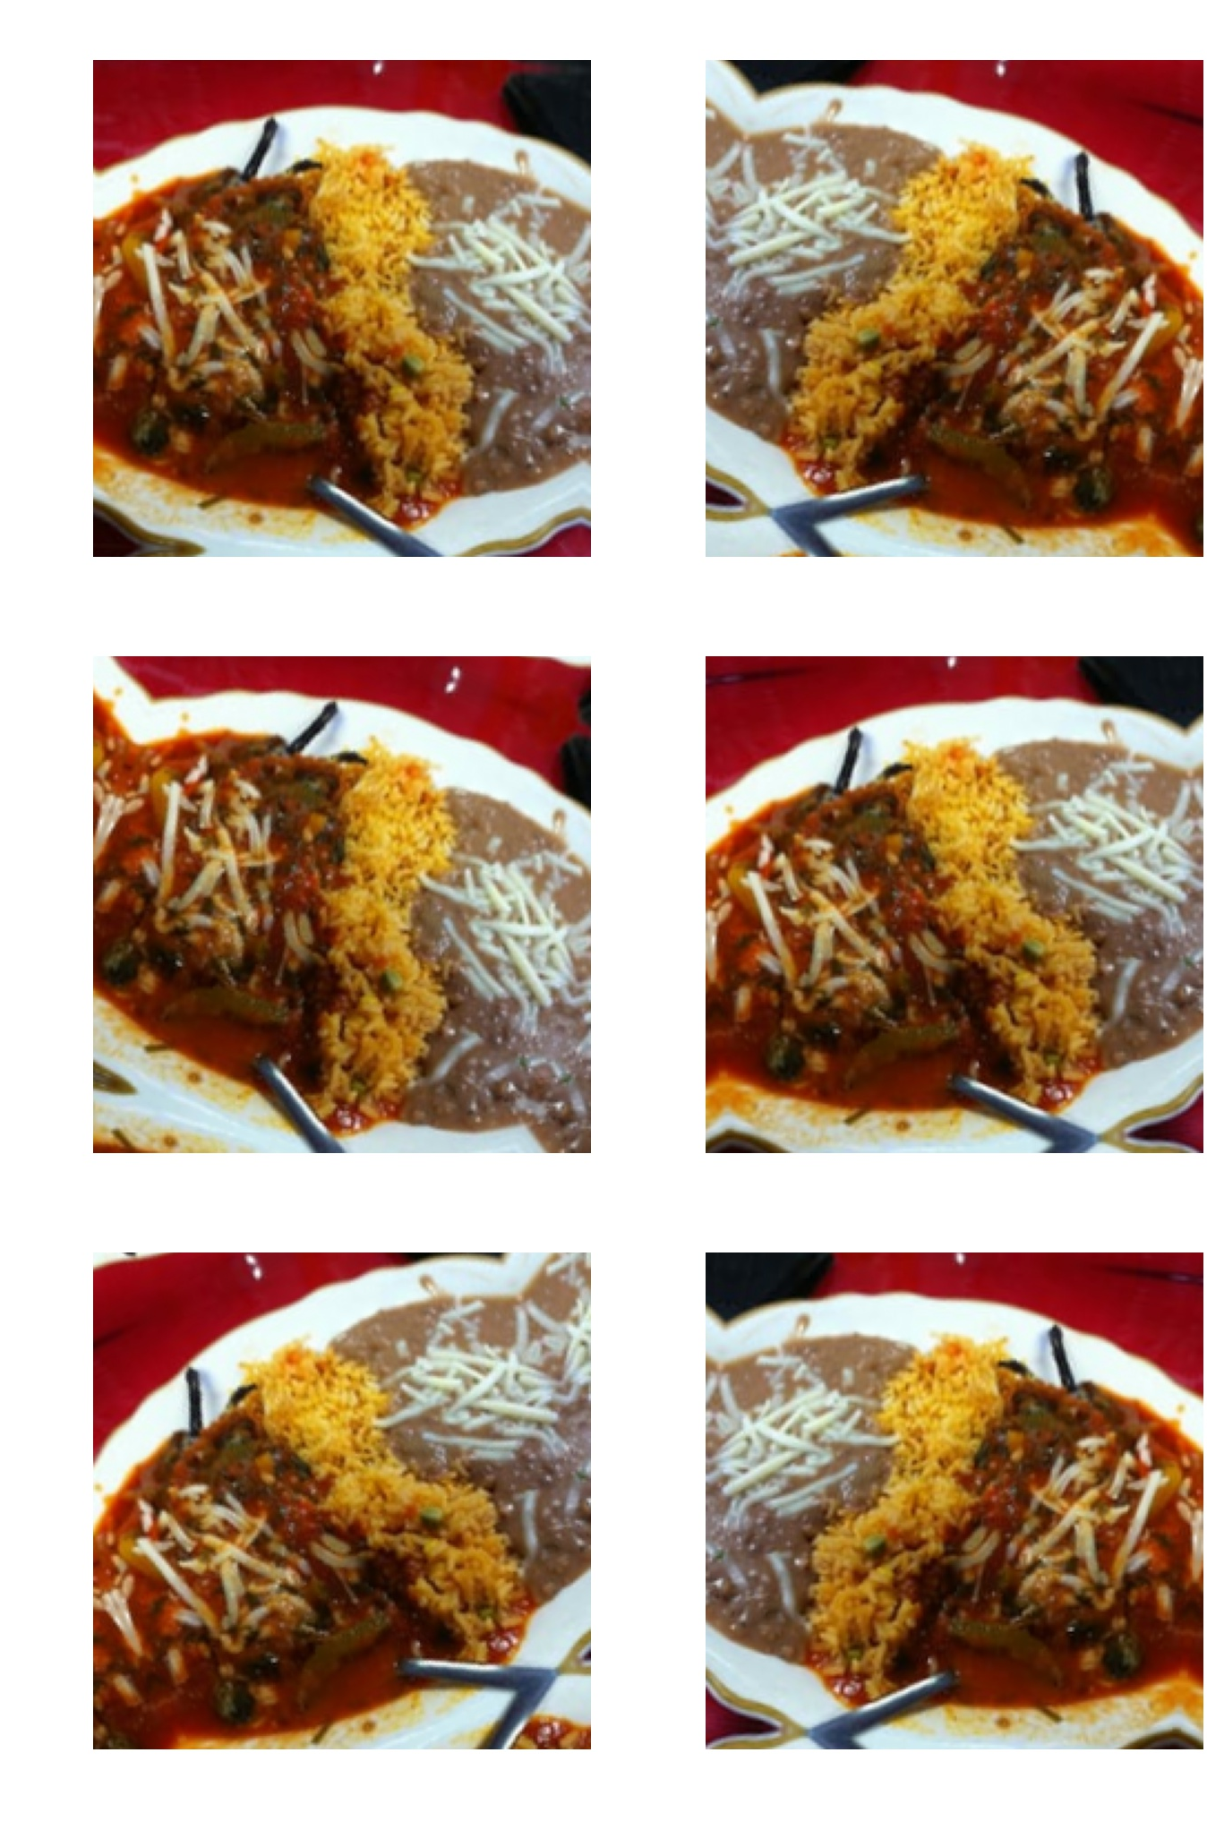
Model 2:
CNN Image classifier from scratch
Model 2: 82% ACC
Batch size: 16, Image size: 256x256 Adds Image Augmentation & Dropout
Model: "sequential_8"
_________________________________________________________________
Layer (type) Output Shape Param #
=================================================================
sequential_7 (Sequential) (None, 256, 256, 3) 0
rescaling_9 (Rescaling) (None, 256, 256, 3) 0
conv2d_18 (Conv2D) (None, 256, 256, 16) 448
max_pooling2d_18 (MaxPoolin (None, 128, 128, 16) 0
g2D)
conv2d_19 (Conv2D) (None, 128, 128, 32) 4640
max_pooling2d_19 (MaxPoolin (None, 64, 64, 32) 0
g2D)
conv2d_20 (Conv2D) (None, 64, 64, 64) 18496
max_pooling2d_20 (MaxPoolin (None, 32, 32, 64) 0
g2D)
dropout (Dropout) (None, 32, 32, 64) 0
flatten_6 (Flatten) (None, 65536) 0
dense_12 (Dense) (None, 128) 8388736
dense_13 (Dense) (None, 1) 129
=================================================================
Total params: 8,412,449
Trainable params: 8,412,449
Non-trainable params: 0
_________________________________________________________________

Slide 24
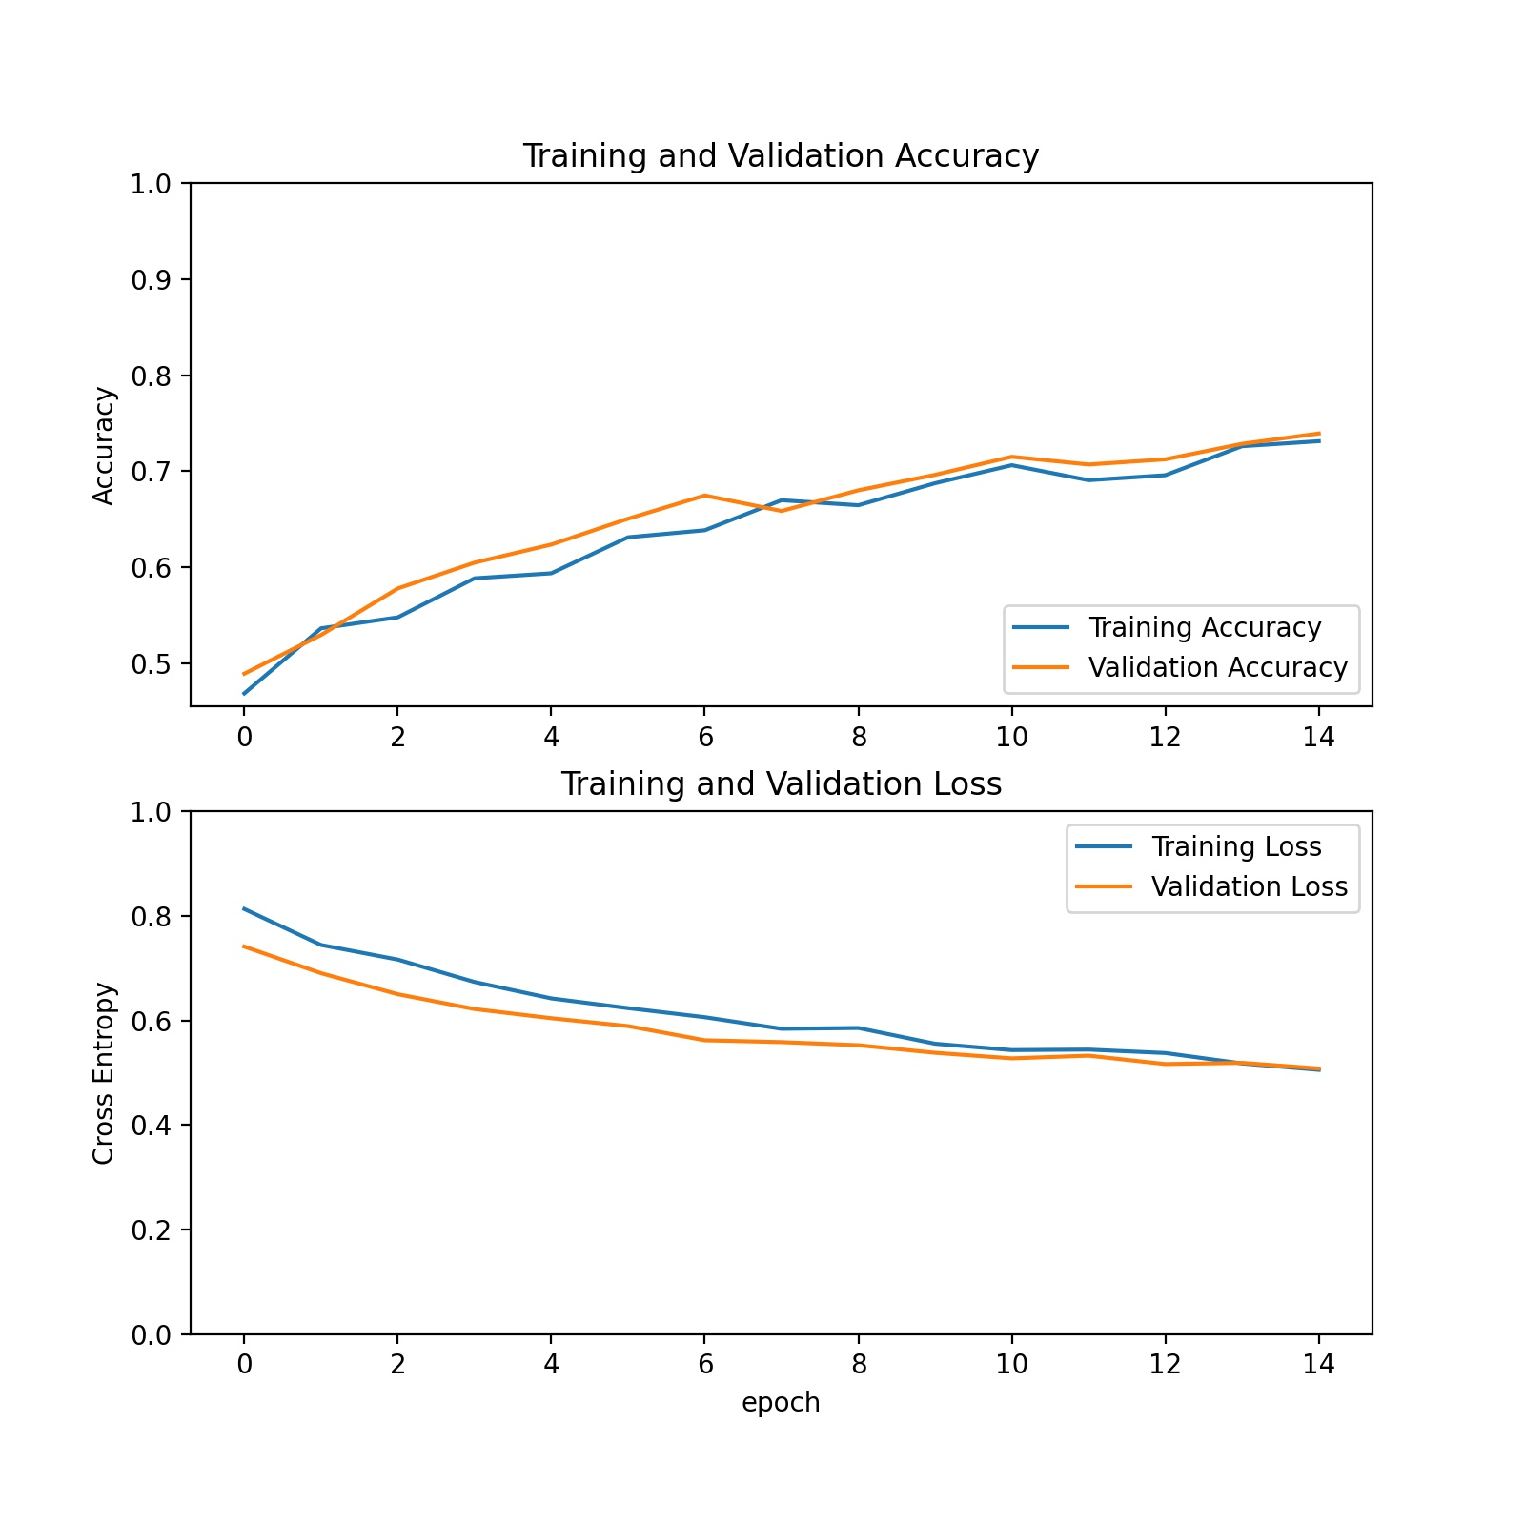
CNN w/ Transfer learning
Model 3: ~73% ACC
~73% on Validation Data after 15 epochs
A feature extraction transfer learning model
Uses MobileNet V2 from Google (1.4 M photos, 1000 classes)
Takes the top off and applies to this data.

Slide 25
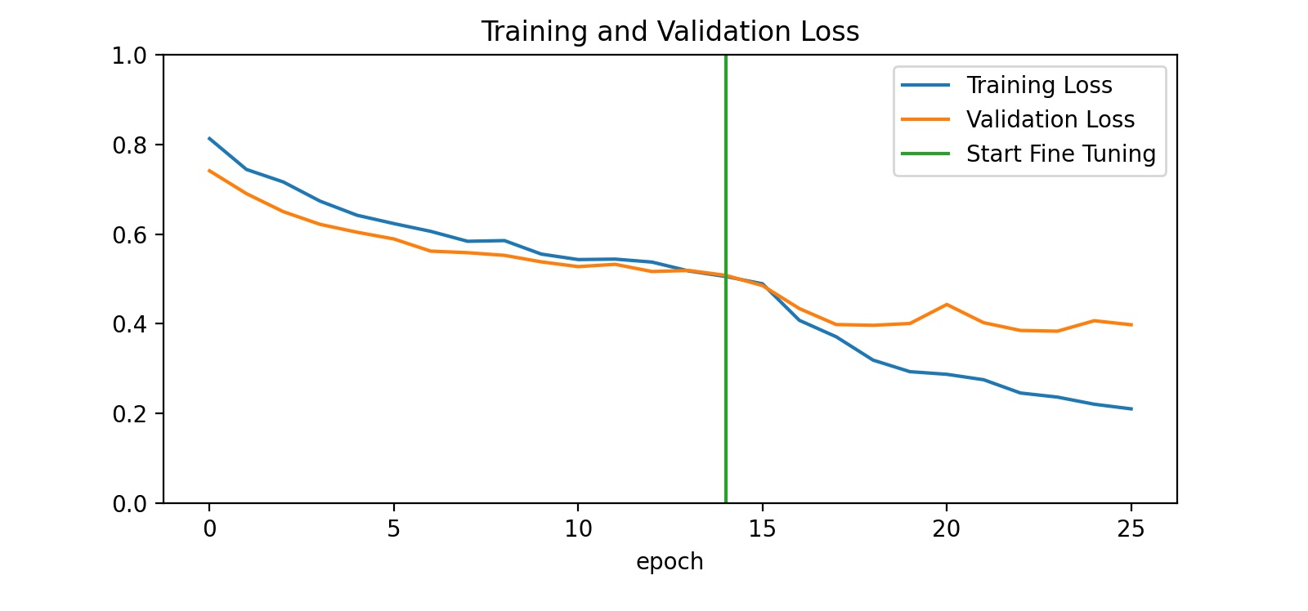
Model 4: ~83% Acc
CNN w/ Transfer learning
~83% on Validation Data after 10 epochs
A fine-tuning transfer learning model
Unfreezes a few of the top layers from the MobileNet V2
Lets you take advantage of basic features in lower part of pre-train, then get more specific for your data.

Slide 26
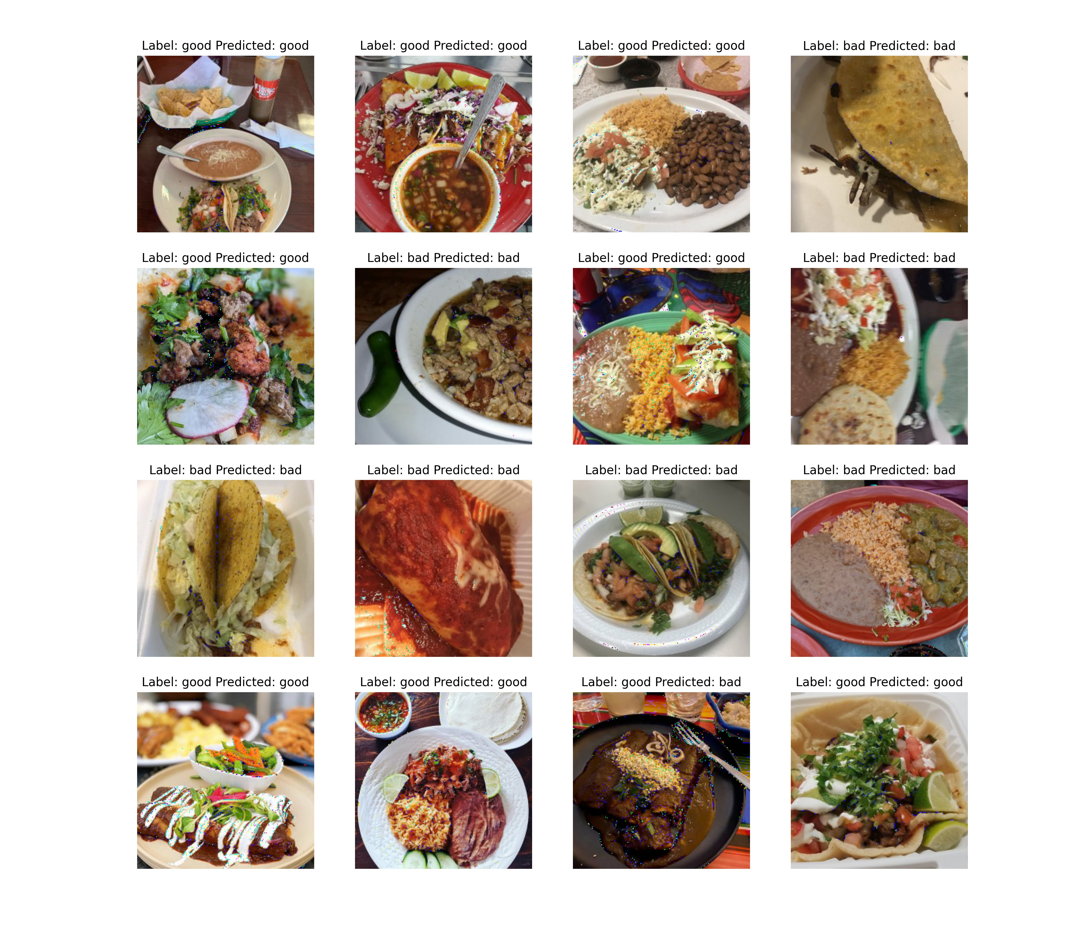
Notes:
Could probably go back through and change some labels. In the circled photo, I probably labeled this good because I like mole sauces, even though this photo probably should be classified as bad according to my criteria. This demonstrates the challenge with using subjective labels.

Slide 27
Conclusions

Slide 28
Conclusions
Text
More difficult to evaluate subjective labels.
Sometimes CNNs with transfer learning don’t perform better than those without.
CNNs: are like poker.
Try limiting down the dataset to more specific shapes(e.g. sushi).
Try a CNN w/ specific architecture for color patterns.
Source
Notes:
Like poker: CNNs are relatively easy to learn, but much goes into mastering them.
There may be legitimate reasons review platforms don’t allow an AI sort of quality photos, that I have not considered.
I would like more time to research subject to find better CNN architectures for this type of classification.

Slide 29
Recommendations

Slide 30
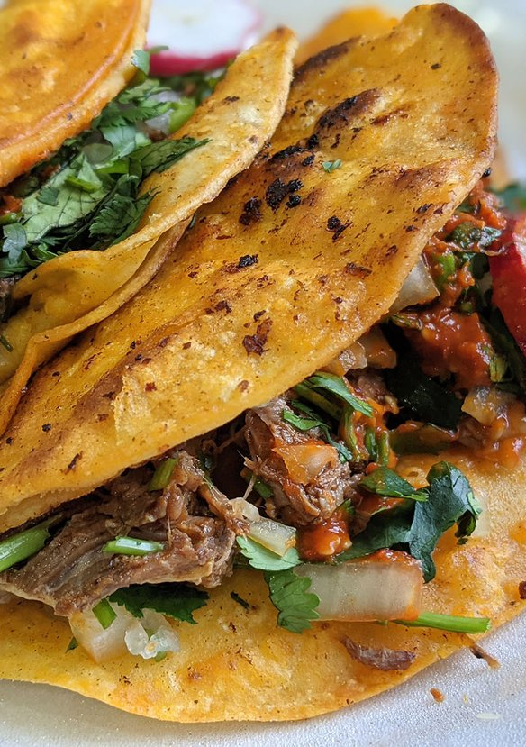
recommendations
Text
Review platforms with user-generated photo galleries should consider implementing AI-based photo-quality sorting.
This idea has other applications beyond review platforms; many are already in production such as on this website: www.pickpik.com

